Slide 1
Classes: A Deeper Look
Based on Chapter 9 of C++ How to Program, 10/e

Slide 2
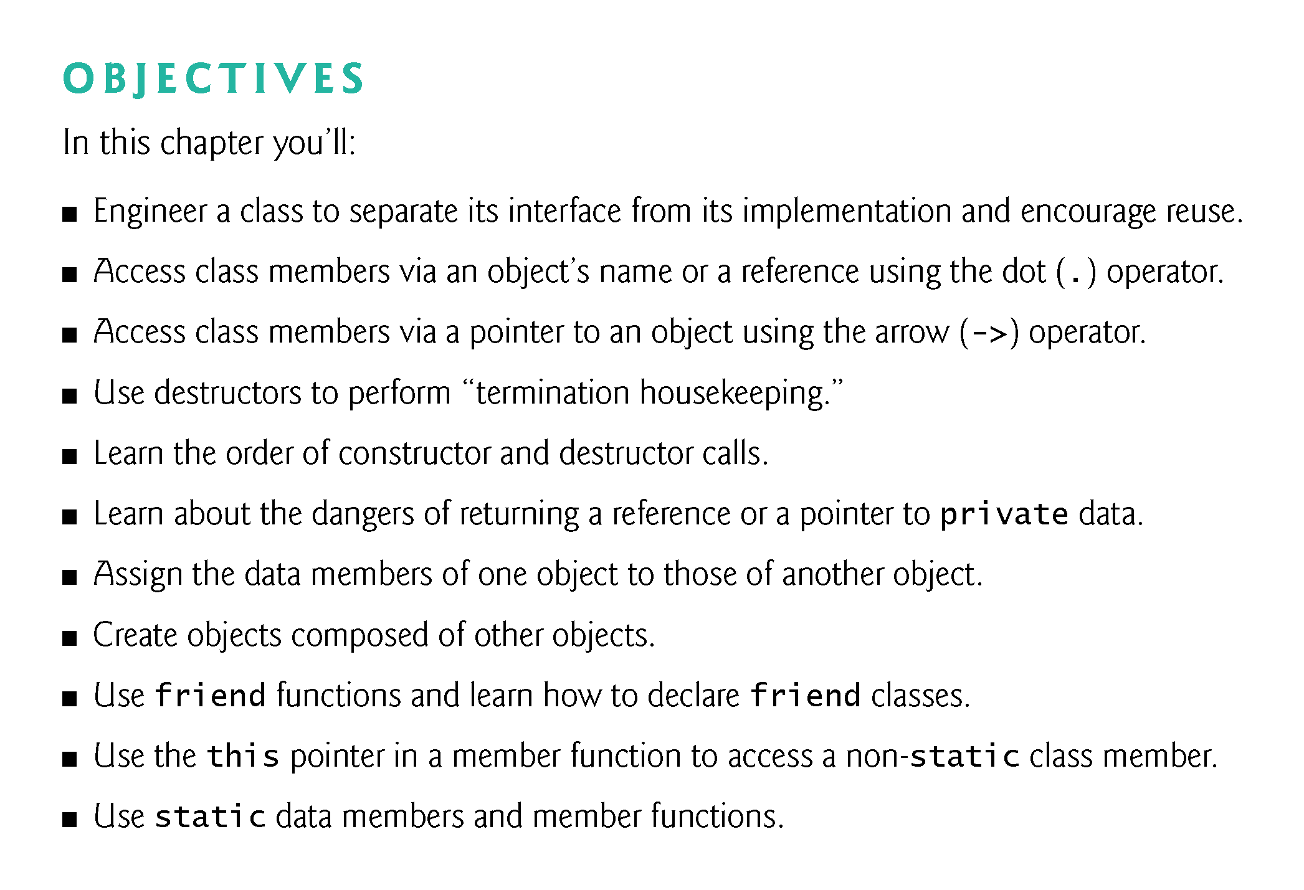

Slide 3
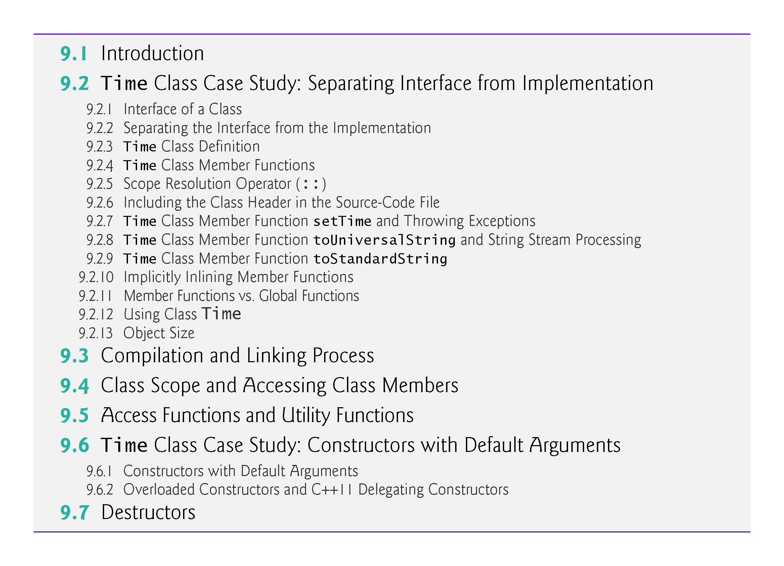

Slide 4
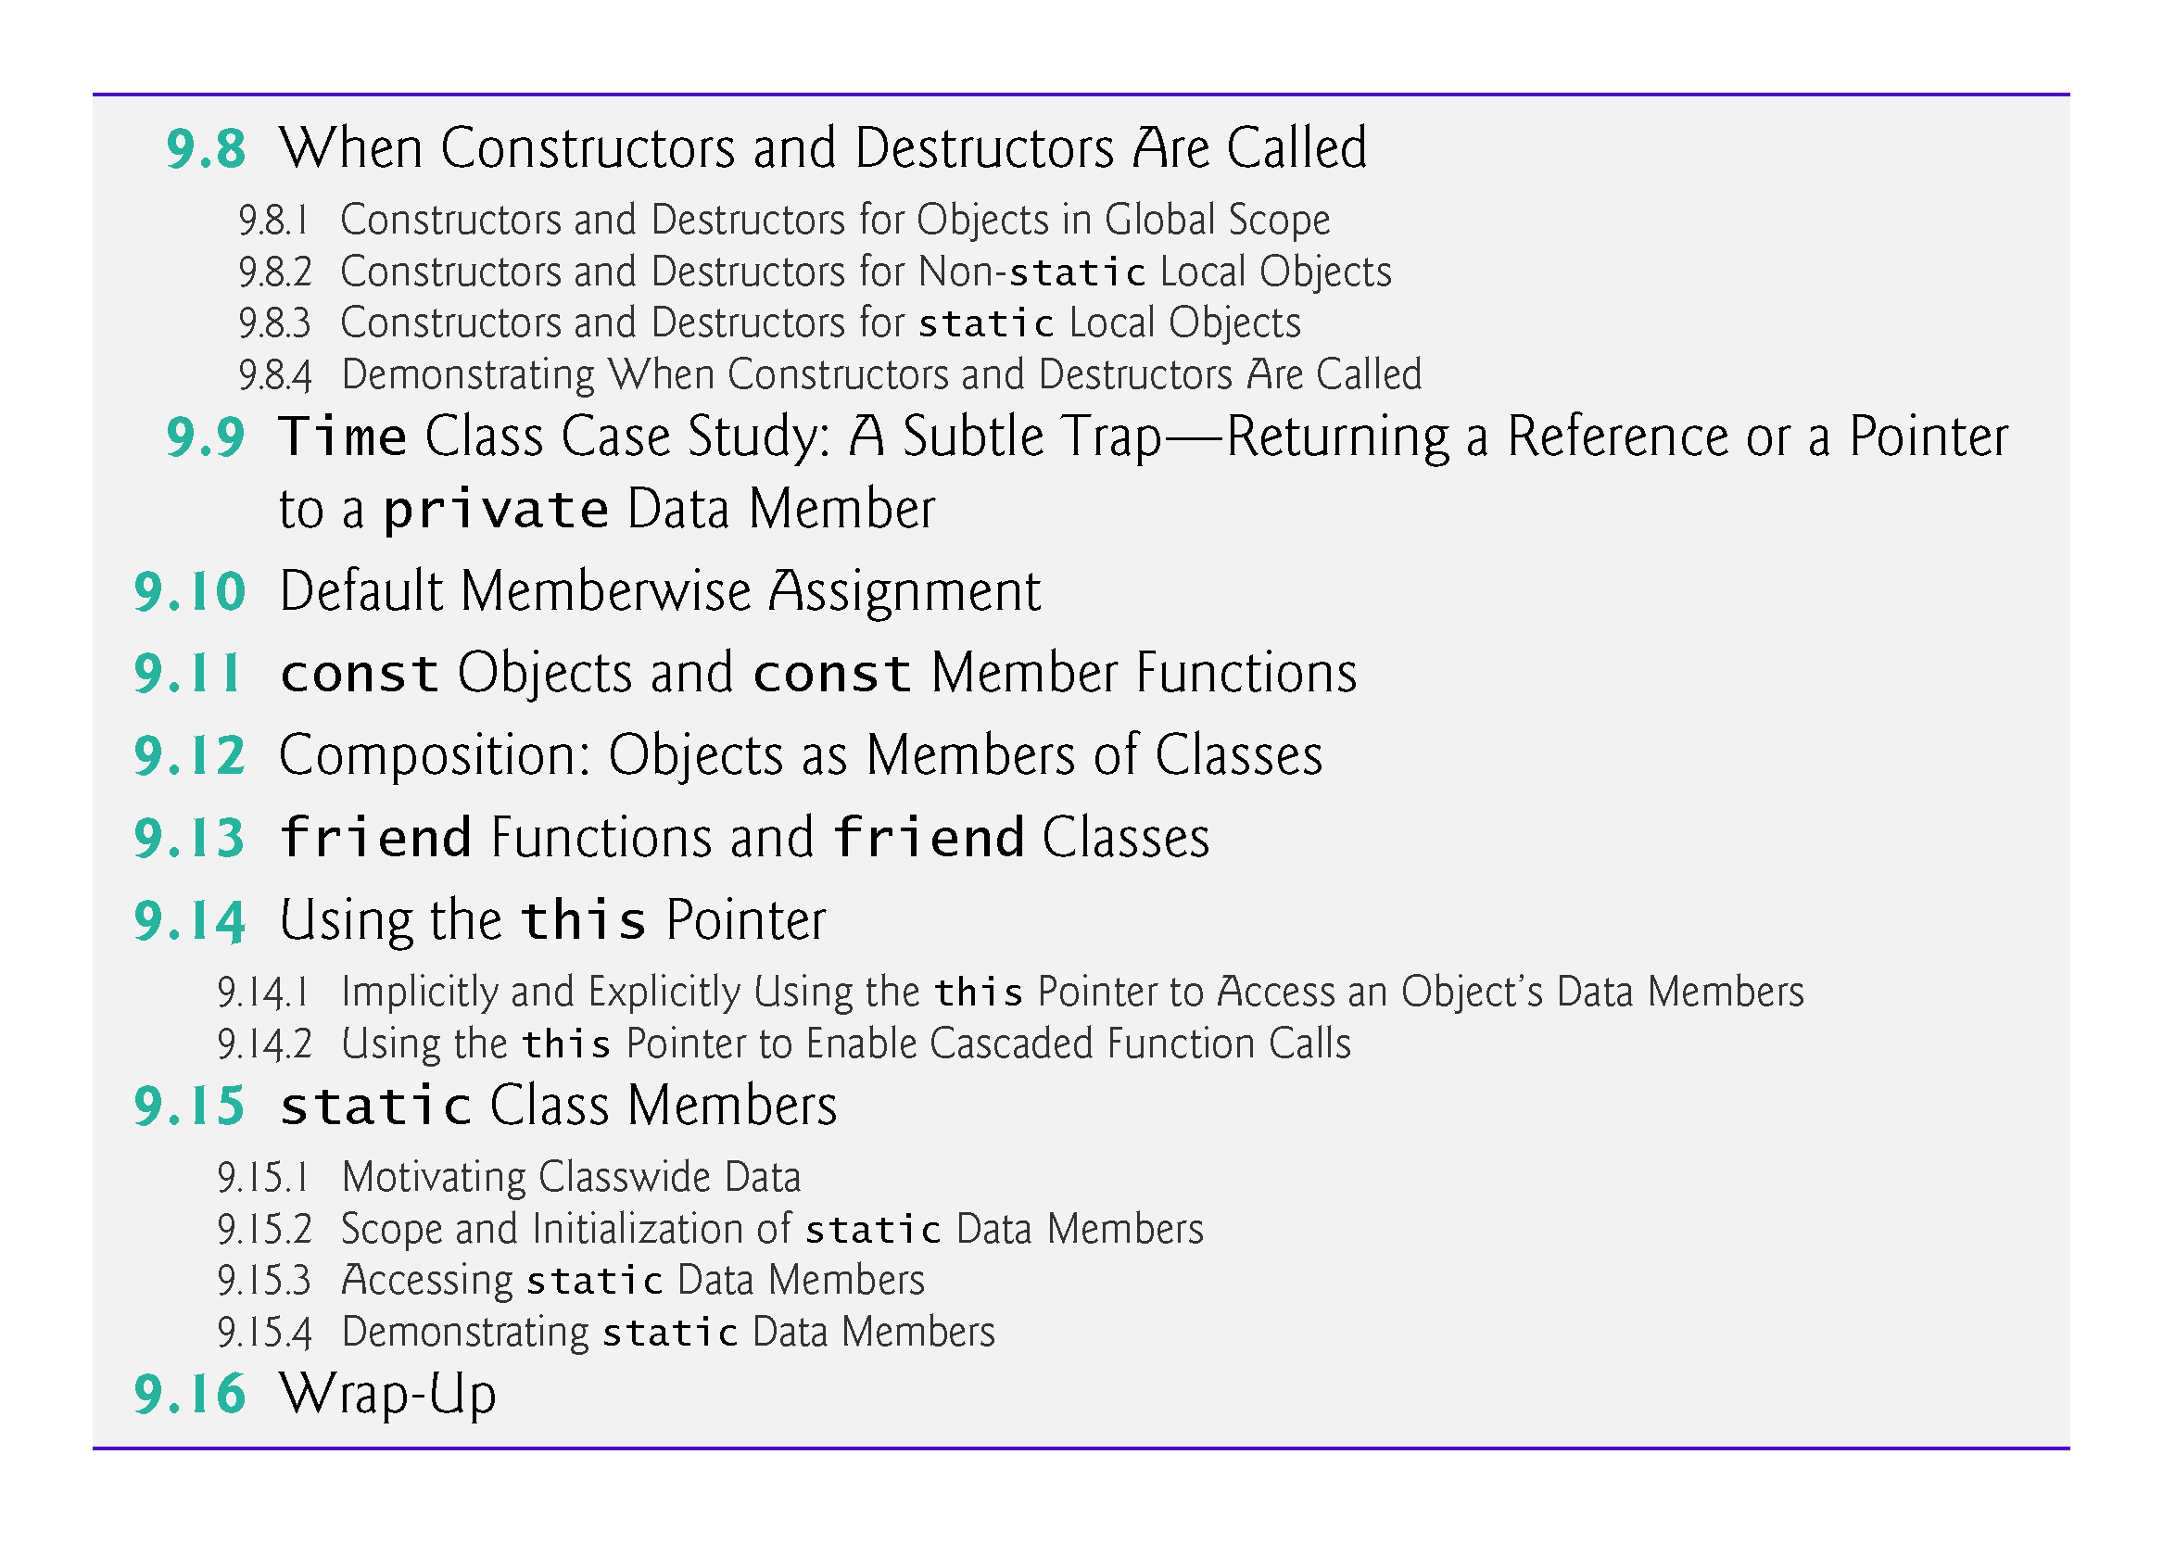

Slide 5
9.1 Introduction
This chapter takes a deeper look at classes.
Coverage includes:
Using an include guard in a header to prevent header code from being included in the same source code file more than once.
Using an ostringstream to create string representations of objects.
An overview of the compile/link process.
Accessing object members via the object’s name, a reference to an object and a pointer to an object.
Access functions that can read or write an object’s data members.
Utility functions—private member functions that support the operation of the class’s public member functions.

Slide 6
9.1 Introduction (cont.)
Coverage includes (cont.):
How default arguments can be used in constructors.
Destructors that perform “termination housekeeping” on objects before they’re destroyed.
The order in which constructors and destructors are called.
How returning a reference or pointer to private data breaks the encapsulation of a class, allowing client code to directly access an object’s data.
Default memberwise assignment to assign an object of a class to another object of the same class.

Slide 7
9.1 Introduction (cont.)
Coverage includes (cont.):
const objects and const member functions to prevent modifications of objects and enforce the principle of least privilege.
Composition—a form of reuse in which a class can have objects of other classes as members.
Friendship to specify that a nonmember function can also access a class’s non-public members—a technique that’s often used in operator overloading for performance reasons.
this pointer, which is an implicit argument in all calls to a class’s non-static member functions, allowing them to access the correct object’s data members and non-static member functions.

Slide 8
9.2 Time Class Case Study
Prior class-definition examples placed a class in a header for reuse, then included the header into a source-code file containing main
Reveals the entire implementation of the class to the class’s clients
Client code (e.g., main) needs to know only
what member functions to call
what arguments to provide to each member function, and
what return type to expect from each member function.
The client code does not need to know how those functions are implemented.

Slide 9
9.2 Time Class Case Study
If client code does know how a class is implemented, the programmer might write client code based on the class’s implementation details.
If an implementation changes, the class’s clients should not have to change.
Hiding the class’s implementation details makes it easier to change the class’s implementation while minimizing, and hopefully eliminating, changes to client code.

Slide 10
9.2.1 Interface of a Class
Interfaces define and standardize the ways in which things such as people and systems interact with one another
A radio’s controls serve as an interface between the radio’s users and its internal components.
The controls allow users to perform a limited set of operations (such as changing the station, adjusting the volume, and choosing between AM and FM stations)
Various radios may implement these operations differently—some provide push buttons, some provide dials and some support voice commands
The interface specifies what operations a radio permits users to perform but does not specify how the operations are implemented inside the radio.

Slide 11
9.2.1 Interface of a Class (cont.)
Interface of a class describes what services a class’s clients can use and how to request those services, but not how the class carries out the services
A class’s public interface consists of the class’s public member functions (also known as the class’s public services)
You can specify a class’s interface by writing a class definition that lists only the class’s member-function prototypes and the class’s data members

Slide 12
9.2.2 Separating the Interface from the Implementation
To separate the class’s interface from its implementation, we break up class Time into
header Time.h (Fig. 9.1) in which class Time is defined, and
source-code file Time.cpp (Fig. 9.2) in which Time’s member functions are defined
Benefits
The class is reusable
The clients of the class know what member functions the class provides, how to call them and what return types to expect, and
the clients do not know how the class’s member functions are implemented.

Slide 13
9.2.2 Separating the Interface from the Implementation
By convention, member-function definitions are placed in a source-code file of the same base name (e.g., Time) as the class’s header but with a .cpp filename extension
The source-code file in Fig. 9.3 defines function main (the client code).
Section 9.3 shows a diagram and explains how this three-file program is compiled from the perspectives of the Time class programmer and the client-code programmer—and what the Time application user sees.

Slide 14
9.2.3 Time Class Definition
The header Time.h (Fig. 9.1) contains Time’s class definition
Function prototypes (lines 13–15) describe the class’s public interface without revealing the member-function implementations
The function prototype in line 13 indicates that setTime requires three int parameters and returns void
The prototypes for member functions toUniversalString and toStandardString (lines 14–15) each specify that the function takes no arguments and returns a string.

Slide 20
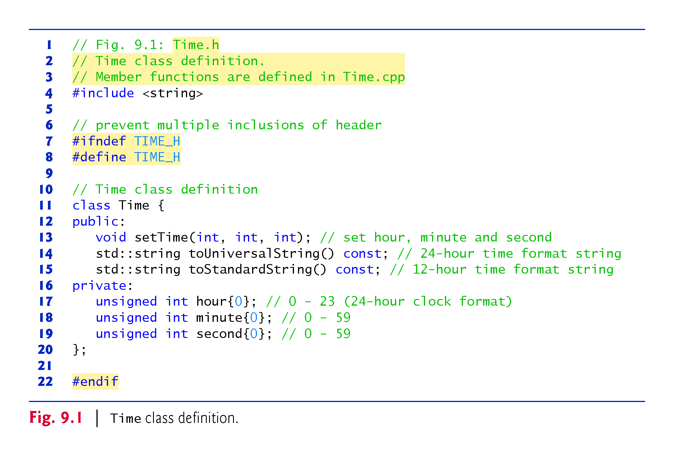

Slide 21
9.2.3 Time Class Definition
The header still specifies the class’s private data members (lines 17–19)
each uses a C++11 in-class list initializer to set the data member to 0
Compiler must know the data members of the class to determine how much memory to reserve for each object of the class
Including the header Time.h in the client code (line 6 of Fig. 9.3) provides the compiler with the information it needs to ensure that the client code calls the member functions of class Time correctly.

Slide 22
9.2.3 Time Class Definition
In Fig. 9.1, the class definition is enclosed in the following include guard:
// prevent multiple inclusions of header file #ifndef TIME_H #define TIME_H ... #endif
Prevents the code between #ifndef (which means “if not defined”) and #endif from being #included if the name TIME_H has been defined
When Time.h is #included the first time, the identifier TIME_H is not yet defined
#define directive defines TIME_H and the preprocessor includes the Time.h header’s contents in the .cpp file
If the header is #included again, TIME_H is defined already and the code between #ifndef and #endif is ignored by the preprocessor

Slide 23
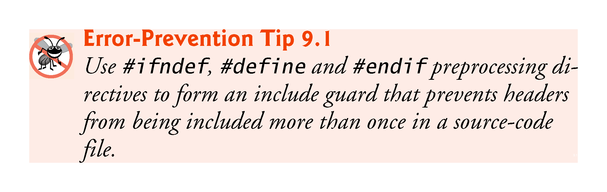

Slide 24
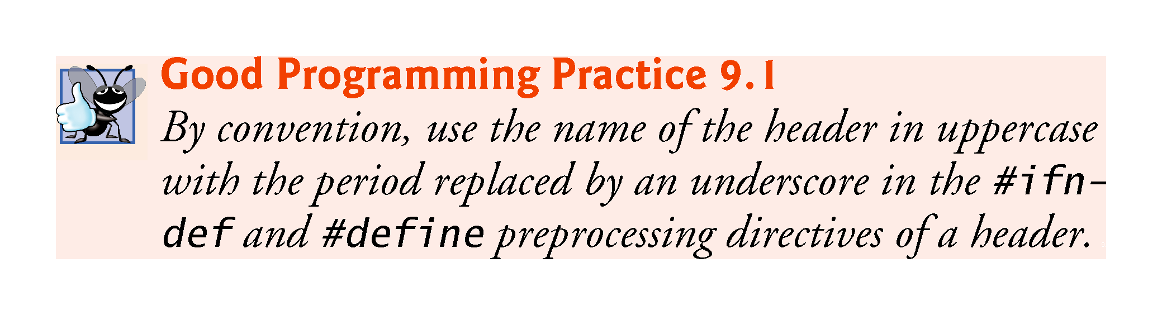

Slide 25
9.2.4 Time Class Member Functions
The source-code file Time.cpp (Fig. 9.2) defines class Time’s member functions, which were declared in lines 13–15 of Fig. 9.1.
For const member functions, the const keyword must appear in both the function prototypes (Fig. 9.1, lines 14–15) and the function definitions (Fig. 9.2, lines 26 and 34)

Slide 26
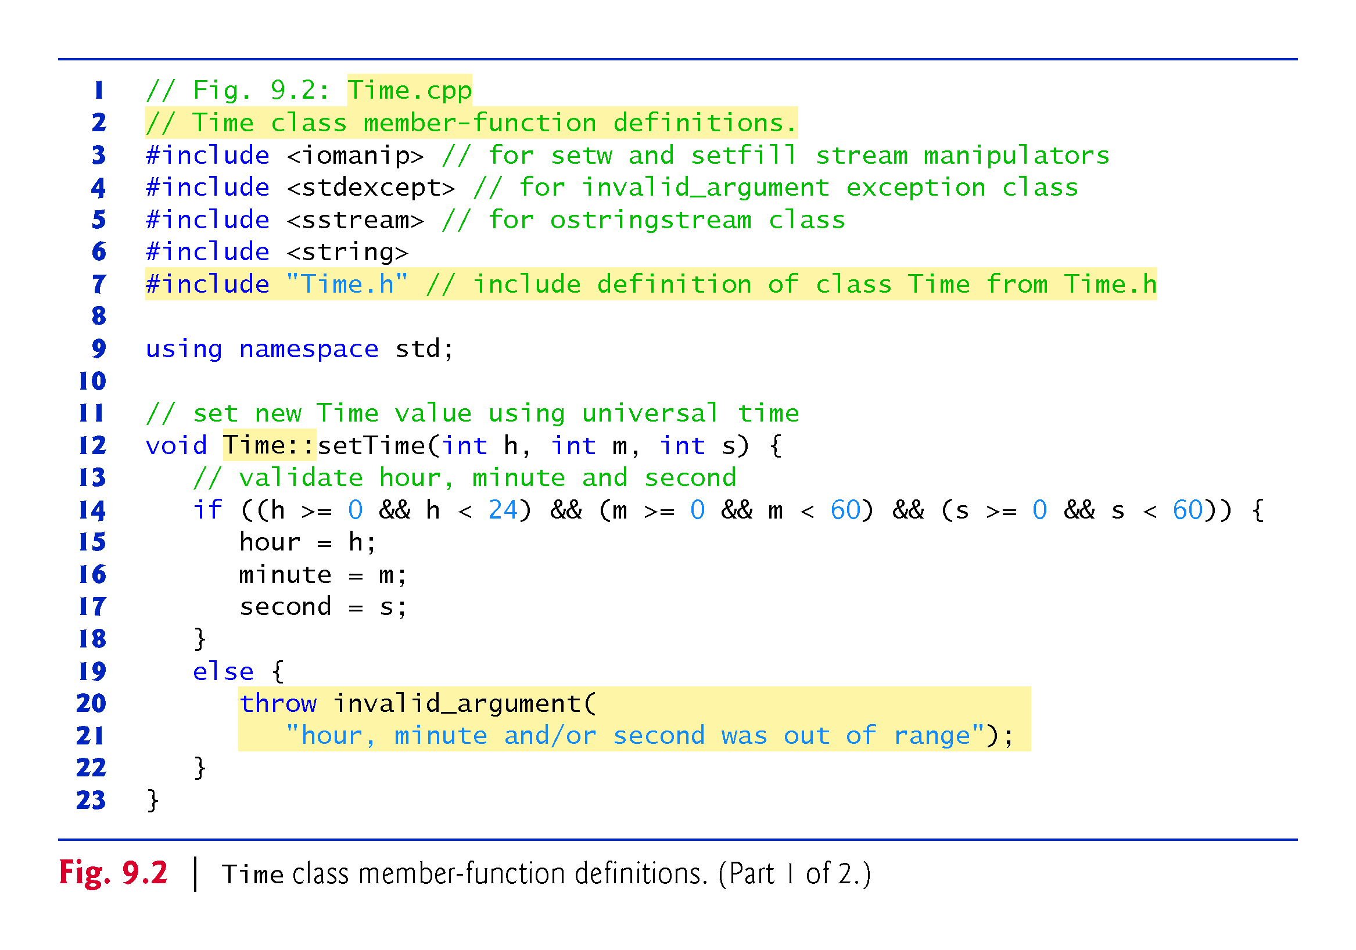

Slide 27
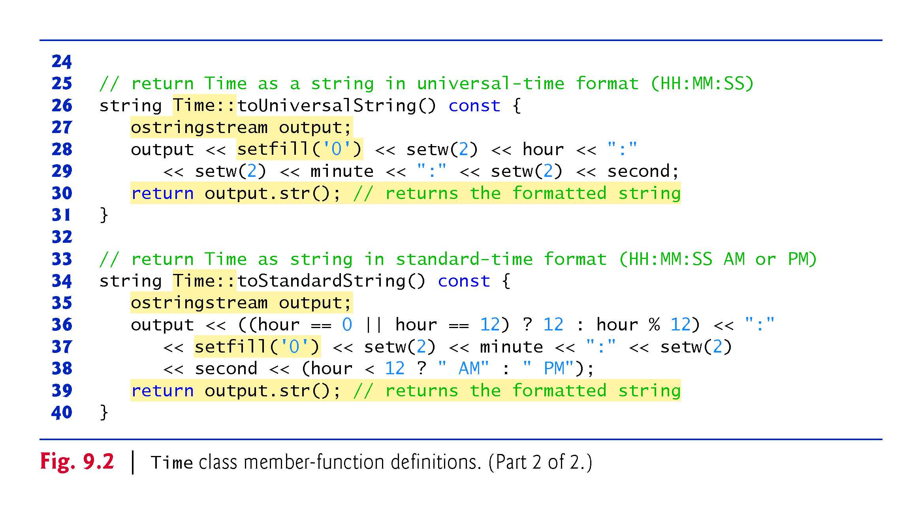

Slide 28
9.2.5 Scope Resolution Operator
Each member function’s name (lines 12, 26 and 34) is preceded by the class name and the scope resolution operator (::)
“ties” them to the (now separate) Time class definition (Fig. 9.1).
Time:: tells the compiler that each member function is within that class’s scope and its name is known to other class members
Without Time:: preceding each function name, these functions would not be recognized by the compiler as Time member functions
Instead, the compiler would consider them “free” or “loose” functions, like main—these are also called global functions
Such functions cannot access Time’s private data or call the class’s member functions, without specifying an object

Slide 29
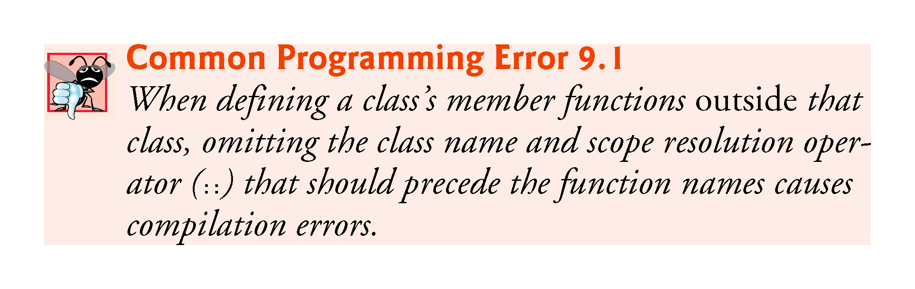

Slide 30
9.2.6 Scope Resolution Operator
To indicate that the member functions in Time.cpp are part of class Time, include the Time.h header (Fig. 9.2, line 7)
allows us to use the class name Time in the Time.cpp file (lines 12, 26 and 34)
When compiling Time.cpp, the compiler uses Time.h to ensure
the first line of each member function (lines 12, 26 and 34) matches its prototype
each member function knows about the class’s data members and other member functions

Slide 31
9.2.7 Time Class Member Function setTime and Throwing Exceptions
Function setTime tests each argument to determine whether the value is in range
If any of the values is outside its range, setTime throws an invalid_argument exception (from header <stdexcept>)
notifies the client code that an invalid argument was received
Can use try…catch to catch exceptions and attempt to recover from them (Fig. 9.3)
The throw statement creates a new object of type invalid_argument, immediately terminates setTime and returns the exception to the code that attempted to set the time

Slide 32
9.2.8 Time Class Member Function toUniversalString and String Stream Processing
toUniversalString returns a string containing the time formatted as universal time with three colon-separated pairs of digits
1:30:07 PM is returned as "13:30:07".
ostringstream (<sstream>) objects provide the same functionality as cout, but write their output to string
ostringstream’s str member function gets the formatted string

Slide 33
9.2.8 Time Class Member Function toUniversalString and String Stream Processing
Parameterized stream manipulator setfill specifies the fill character that’s displayed when an integer is output in a field wider than the number of digits in the value
fill characters appear to the left of the digits in the number, because the number is right aligned by default
for left-aligned values (specified with the left stream manipulator) the fill characters would appear to the right
If the minute value is 2, it will be displayed as 02, because the fill character is set to zero ('0')
If the number being output fills the specified field, the fill character will not be displayed

Slide 34
9.2.8 Time Class Member Function toUniversalString and String Stream Processing
Once the fill character is specified with setfill, it applies for all subsequent values that are displayed in fields wider than the value being displayed
setfill is a sticky setting
This is in contrast to setw, which applies only to the next value displayed
setw is a nonsticky setting
Line 30 calls ostringstream’s str member function to get the formatted string, which is returned to the client.

Slide 35
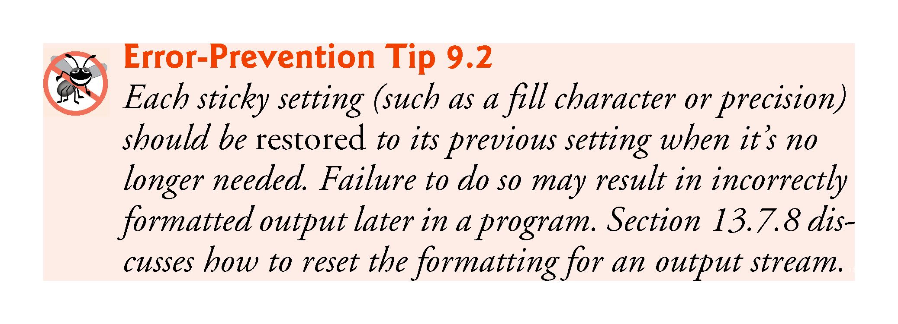

Slide 36
9.2.9 Time Class Member Function toStandardString
toStandardString returns a string containing the time formatted as standard time with the hour, minute and second values separated by colons and followed by an AM or PM indicator
10:54:27 AM and 1:27:06 PM
Line 36 uses the conditional operator (?:) to determine the value of hour to be displayed—if the hour is 0 or 12 (AM or PM, respectively), it appears as 12; otherwise, we use the remainder operator (%) to have the hour appear as a value from 1 to 11
The conditional operator in line 38 determines whether AM or PM will be displayed.
Line 39 calls ostringstream’s str member function to return the formatted string.

Slide 37
9.2.10 Implicitly Inlining Member Functions
If a member function is defined in the class’s body, the compiler attempts to inline calls to the member function.

Slide 38
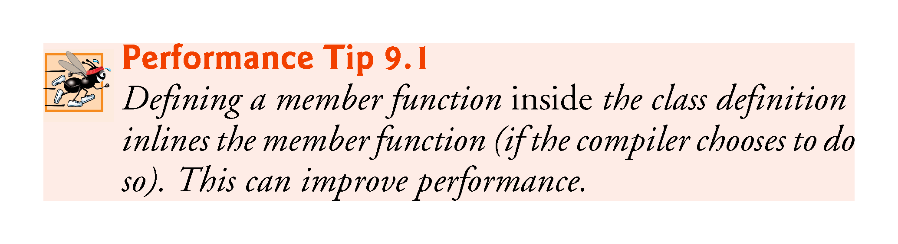

Slide 39
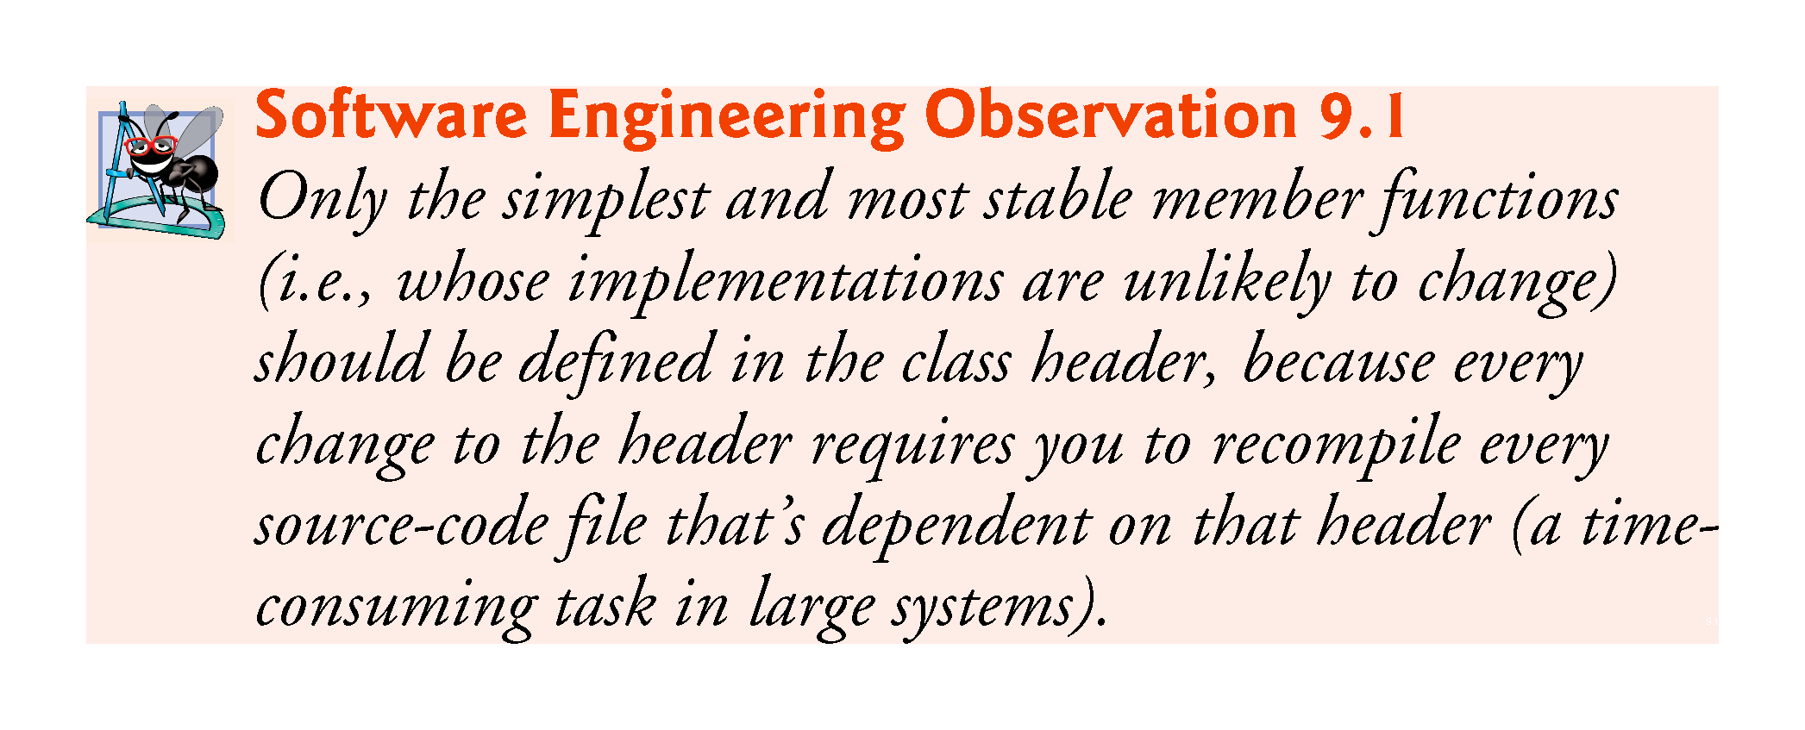

Slide 40
9.2.11 Implicitly Inlining Member Functions
toUniversalString and toStandardString take no arguments, because these member functions implicitly know that they’re to create string representations of the data for the particular Time object on which they’re invoked
Can make member-function calls more concise than conventional function calls in procedural programming

Slide 41
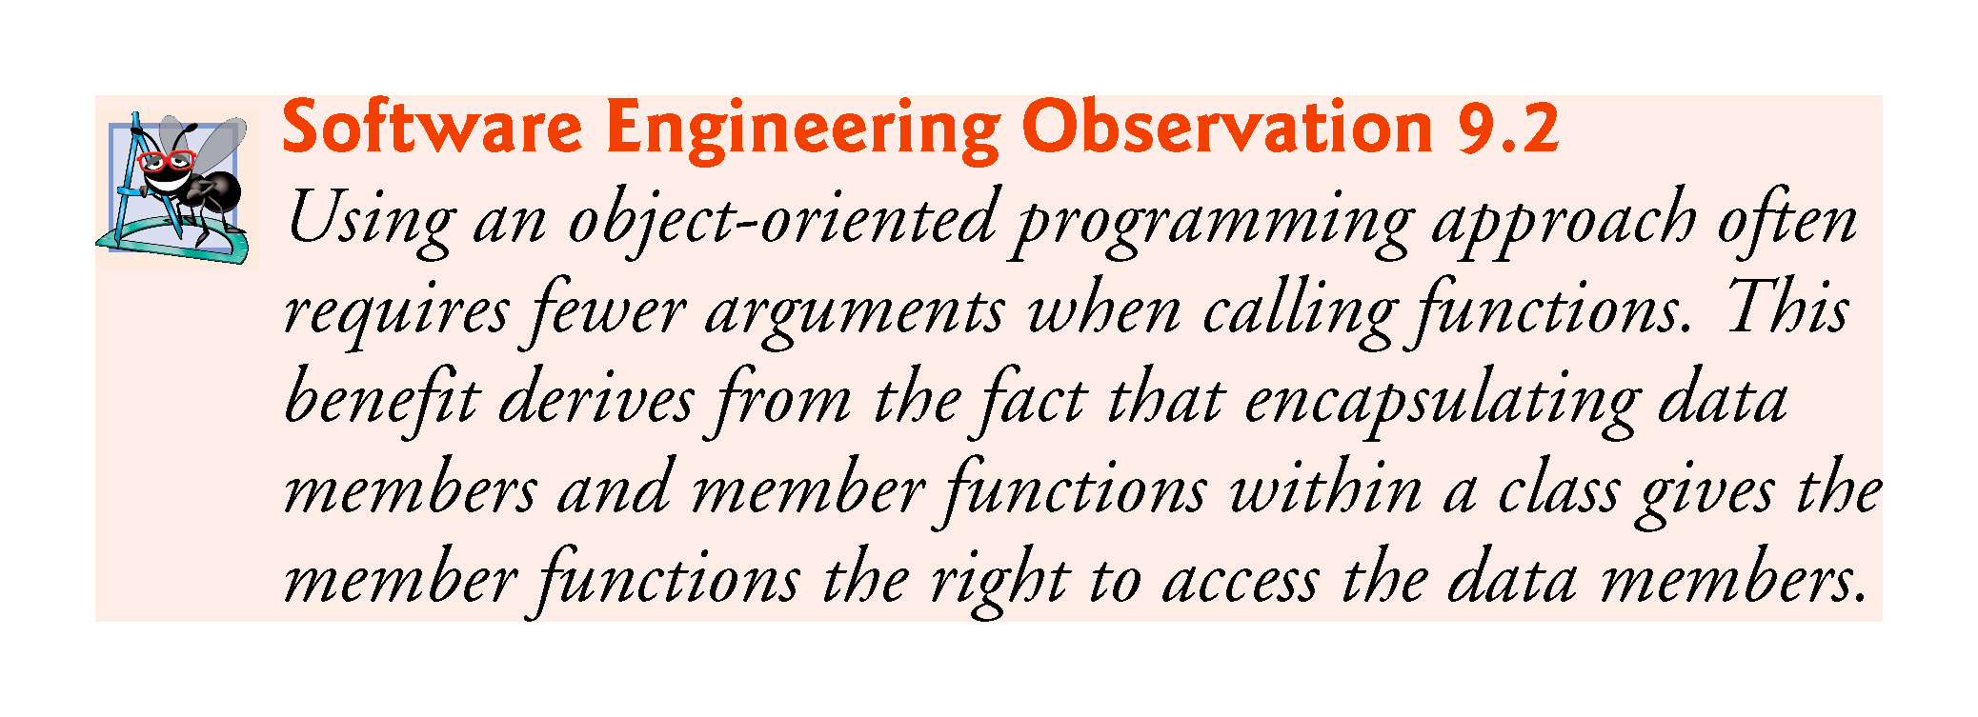

Slide 42
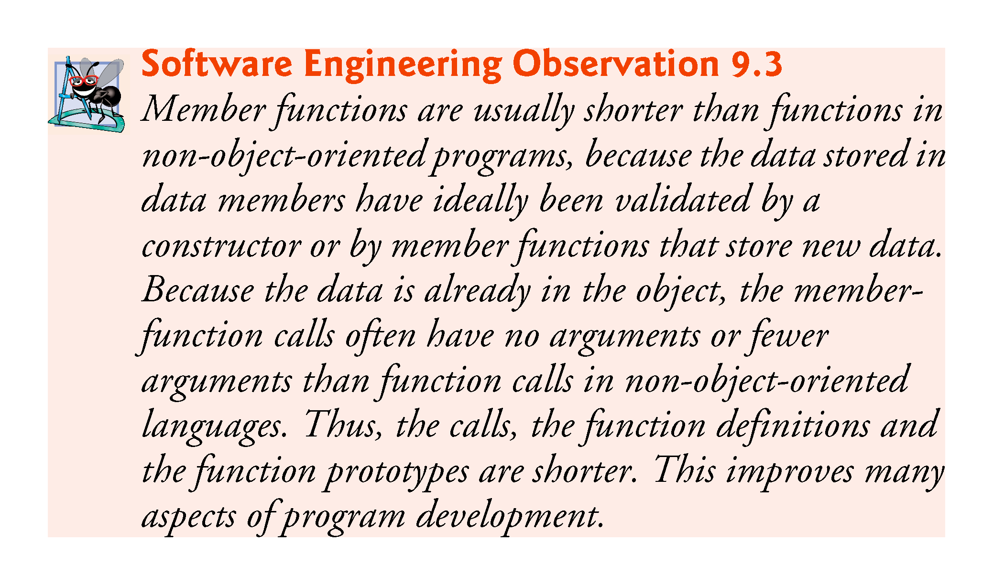

Slide 43
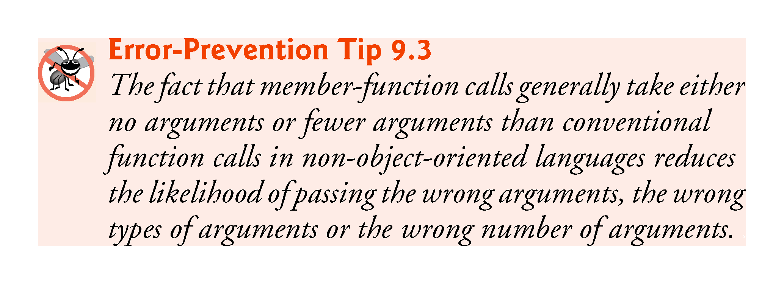

Slide 44
9.2.12 Using Class Time
Time can be used as a type in object, array, pointer and reference declarations as follows:
Time sunset; // object of type Time
array< Time, 5 > arrayOfTimes; // array of 5 Time objects
Time &dinnerTime = sunset; // reference to a Time object
Time *timePtr = &dinnerTime; // pointer to a Time object
Figure 9.3 uses class Time
Separating Time’s interface from the implementation of its member functions does not affect the way that this client code uses the class

Slide 45
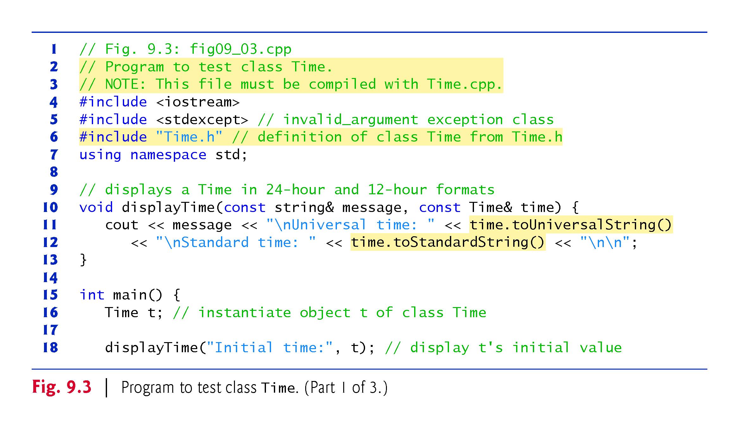

Slide 46
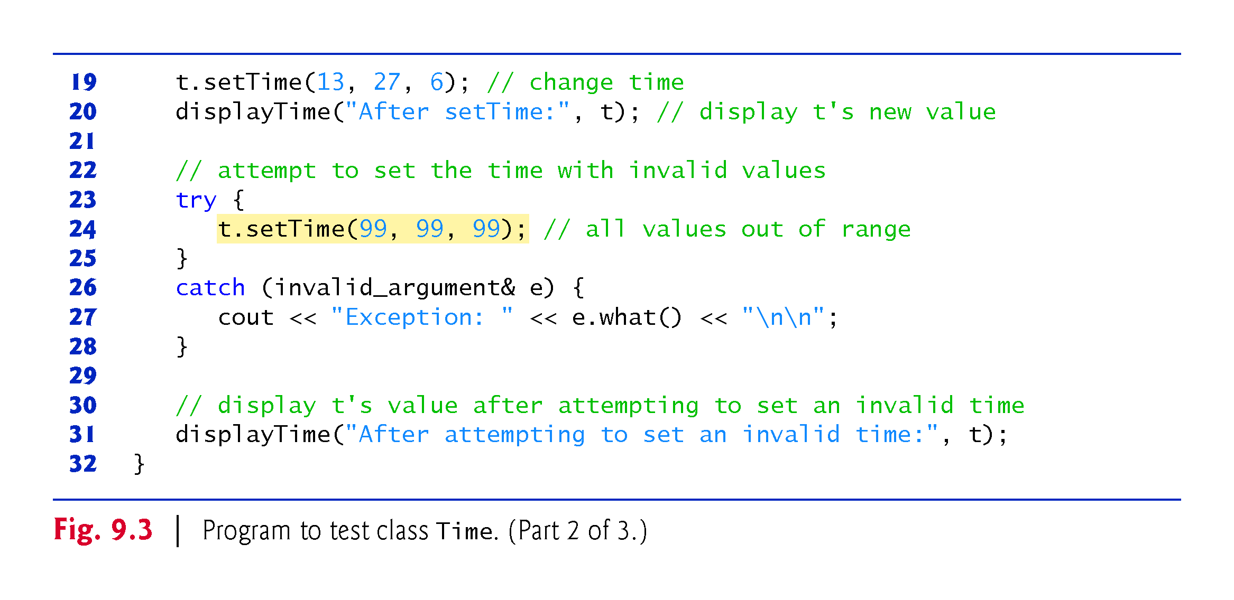

Slide 47
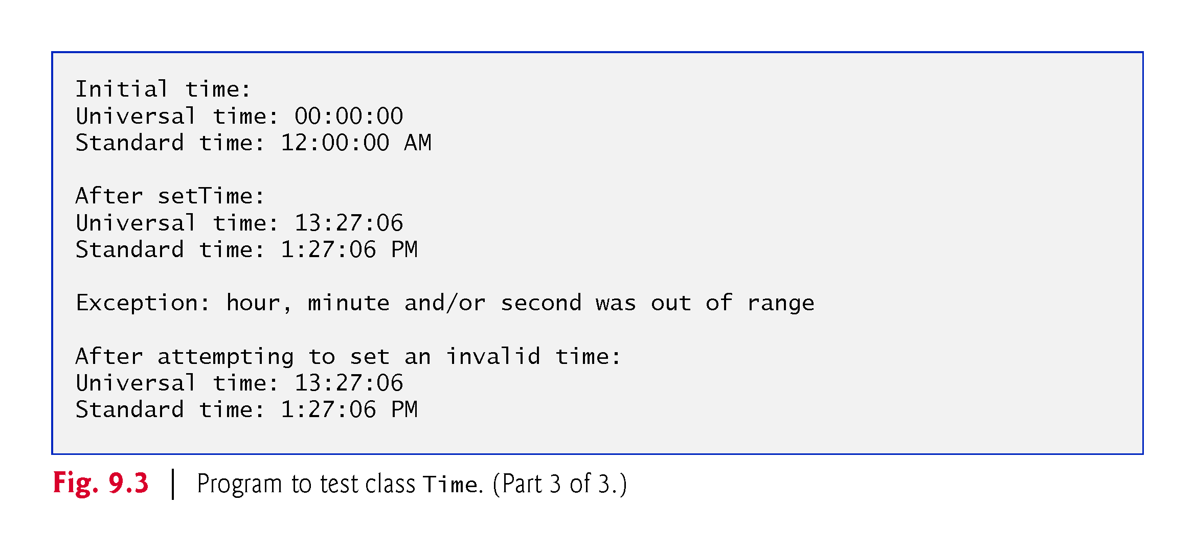

Slide 48
9.2.12 Using Class Time
Line 16 creates the Time object t
Recall that class Time does not define a constructor, so line 16 invokes the compiler-generated default constructor, and t’s hour, minute and second are set to 0 via their initializers in class Time’s definition
To illustrate that the setTime member function validates its arguments, line 24 calls setTime with invalid arguments
This statement is placed in a try block
When an exception occurs, it’ s caught at lines 26–28, and line 27 displays the exception’s error message by calling its what member function
Line 31 displays the time again to confirm that setTime did not change the time when invalid arguments were supplied

Slide 49
9.2.13 Object Size
People new to object-oriented programming often suppose that objects must be quite large because they contain data members and member functions.
Logically, this is true—you may think of objects as containing data and functions (and our discussion has certainly encouraged this view); physically, however, this is not true.

Slide 50
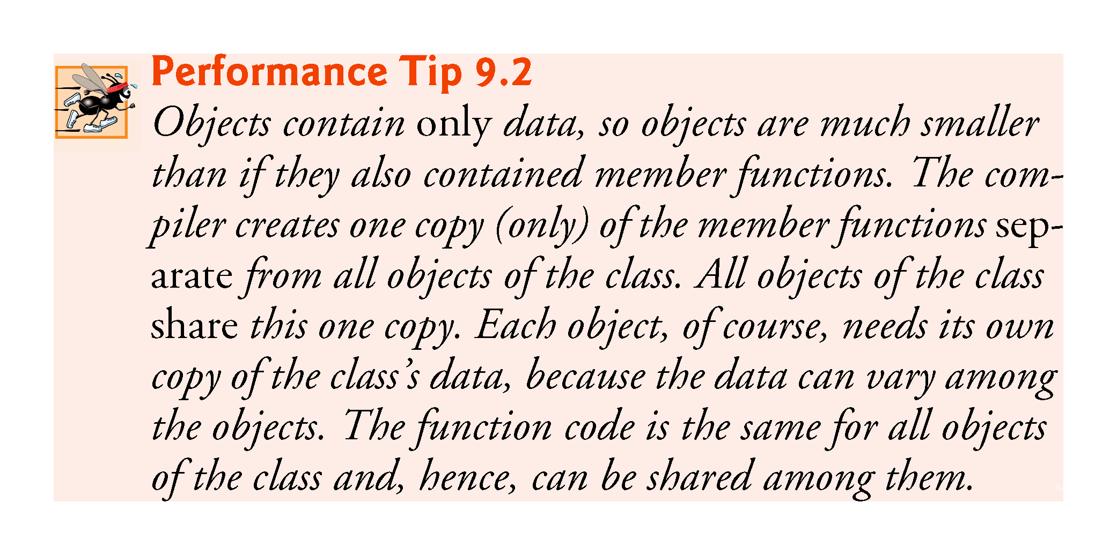

Slide 51
9.3 Compilation and Linking Process
The diagram in Fig. 9.4 shows the compilation and linking process that results in an executable Time application
Often a class’s interface and implementation will be created and compiled by one programmer and used by a separate programmer who implements the client code that uses the class
Diagram shows what’s required by both the class-implementation programmer and the client-code programmer
Dashed lines show the pieces required by the class-implementation programmer, the client-code programmer and the Time application user, respectively

Slide 52
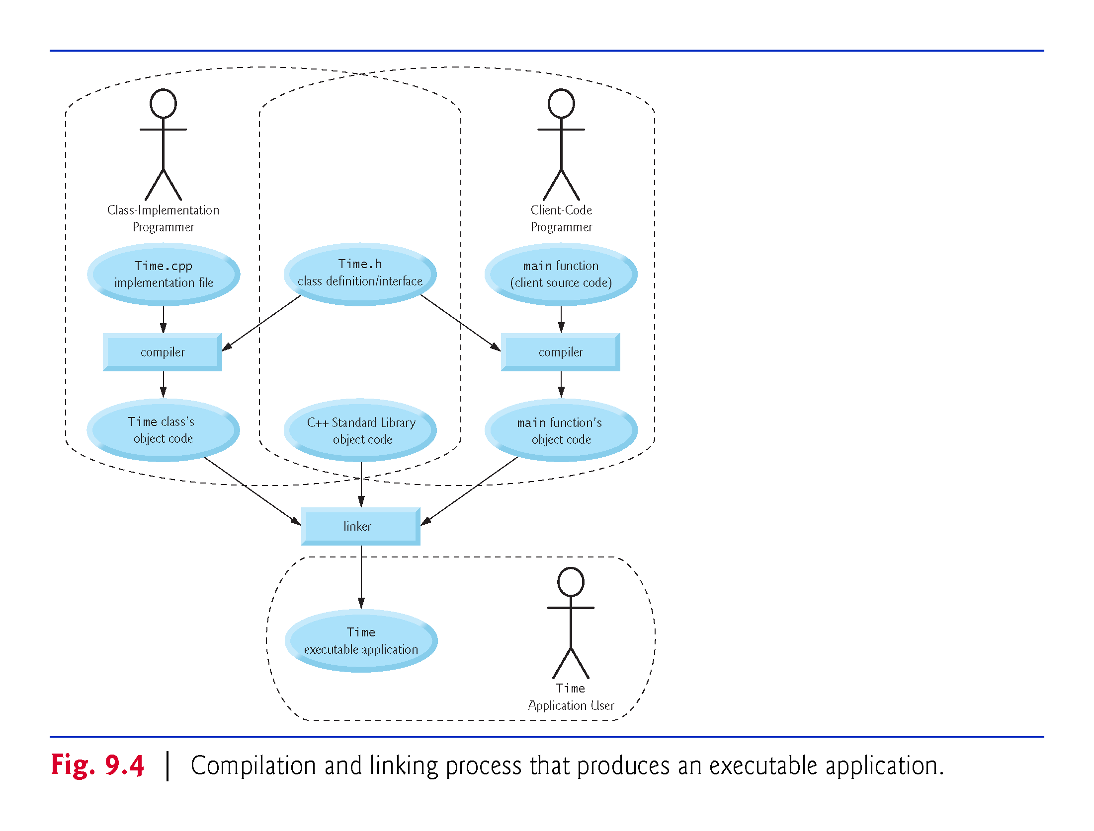

Slide 53
9.3 Compilation and Linking Process
A class-implementation programmer responsible for creating a reusable Time class creates the header Time.h and the source-code file Time.cpp that #includes the header, then compiles the source-code file to create Time’s object code
To hide the class’s member-function implementation details, the class-implementation programmer would provide the client-code programmer with the header Time.h (which specifies the class’s interface and data members) and the Time object code (i.e., the machine-code instructions that represent Time’s member functions).

Slide 54
9.3 Compilation and Linking Process
The client-code programmer is not given Time.cpp, so the client remains unaware of how Time’s member functions are implemented
The client-code programmer needs to know only Time’s interface to use the class and must be able to link its object code
Since the interface of the class is part of the class definition in the Time.h header, the client-code programmer must have access to this file and must #include it in the client’s source-code file
When the client code is compiled, the compiler uses the class definition in Time.h to ensure that the main function creates and manipulates objects of class Time correctly

Slide 55
9.3 Compilation and Linking Process
To create the executable Time application, the last step is to link
the object code for the main function (i.e., the client code),
the object code for class Time’s member-function implementations, and
the C++ Standard Library object code for the C++ classes (e.g., string) used by the class-implementation programmer and the client-code programmer.
The linker’s output is the executable Time application that users can execute to create and manipulate a Time object
Compilers and IDEs typically invoke the linker for you after compiling your code

Slide 56
9.4 Class Scope and Accessing Class Members
A class’s data members and member functions belong to that class’s scope.
Nonmember functions are defined at global namespace scope, by default.
Within a class’s scope, class members are immediately accessible by all of that class’s member functions and can be referenced by name.
Outside a class’s scope, public class members are referenced through one of the handles on an object—an object name, a reference to an object or a pointer to an object.

Slide 57
9.4 Class Scope and Accessing Class Members (cont.)
Dot (.) and Arrow (->) Member Selection Operators
As you know, you can use an object’s name—or a reference to an object—followed by the dot member-selection operator (.) to access an object’s members
To reference an object’s members via a pointer to an object, follow the pointer name by the arrow member-selection operator (->) and the member name, as in pointerName->memberName.

Slide 58
9.4 Class Scope and Accessing Class Members (cont.)
Accessing public Class Members Through Objects, References and Pointers
Consider an Account class that has a public setBalance member function. Given the following declarations:
Account account; // an Account object
// accountRef refers to an Account object
Account &accountRef = account;
// accountPtr points to an Account object
Account *accountPtr = &account;

Slide 59
9.4 Class Scope and Accessing Class Members (cont.)
You can invoke member function setBalance using the dot (.) and arrow (->) member selection operators as follows:
// call setBalance via the Account object
account.setBalance( 123.45 );
// call setBalance via a reference to the Account object
accountRef.setBalance( 123.45 );
// call setBalance via a pointer to the Account object
accountPtr->setBalance( 123.45 );

Slide 60
9.5 Access Functions and Utility Functions
Access Functions
Access functions can read or display data.
A common use for access functions is to test the truth or falsity of conditions—such functions are often called predicate functions.
Utility Functions
A utility function (also called a helper function) is a private member function that supports the operation of the class’s other member functions.

Slide 61
9.6 Time Class Case Study: Constructors with Default Arguments
The program of Figs. 9.4–9.6 enhances class Time to demonstrate how arguments are implicitly passed to a constructor.

Slide 62
9.6.1 Constructors with Default Arguments
Like other functions, constructors can specify default arguments.
Line 13 of Fig. 9.5 declares a Time constructor with default arguments, specifying a default value of zero for each argument passed to the constructor
The constructor is declared explicit because it can be called with one argument
We discuss explicit constructors in detail in Section 10.13

Slide 63
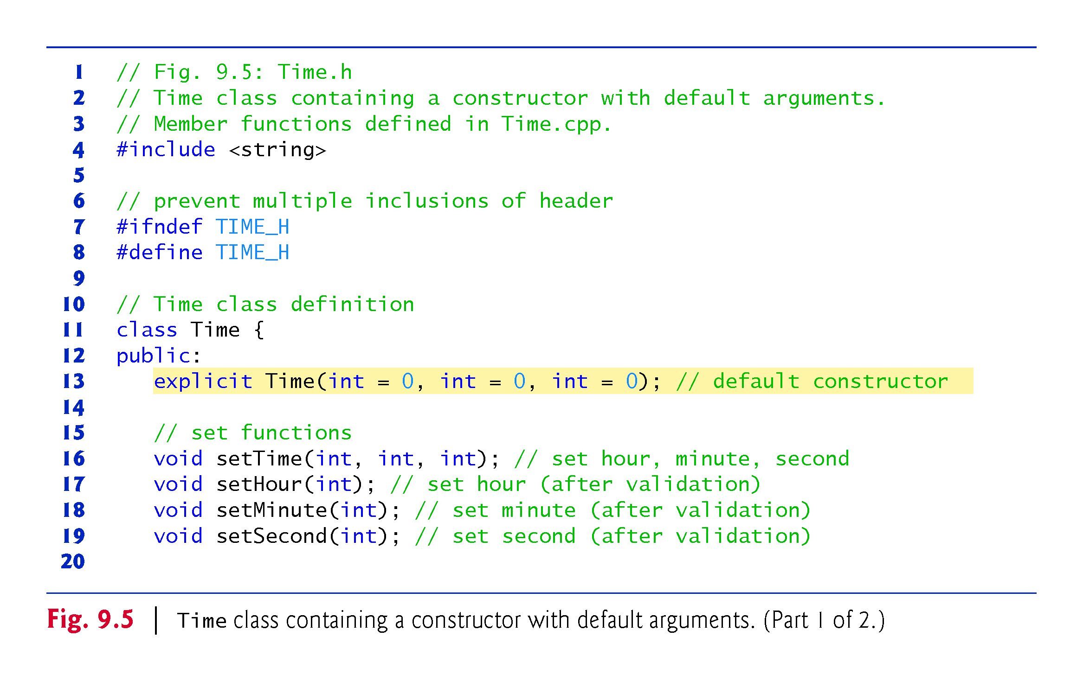

Slide 64
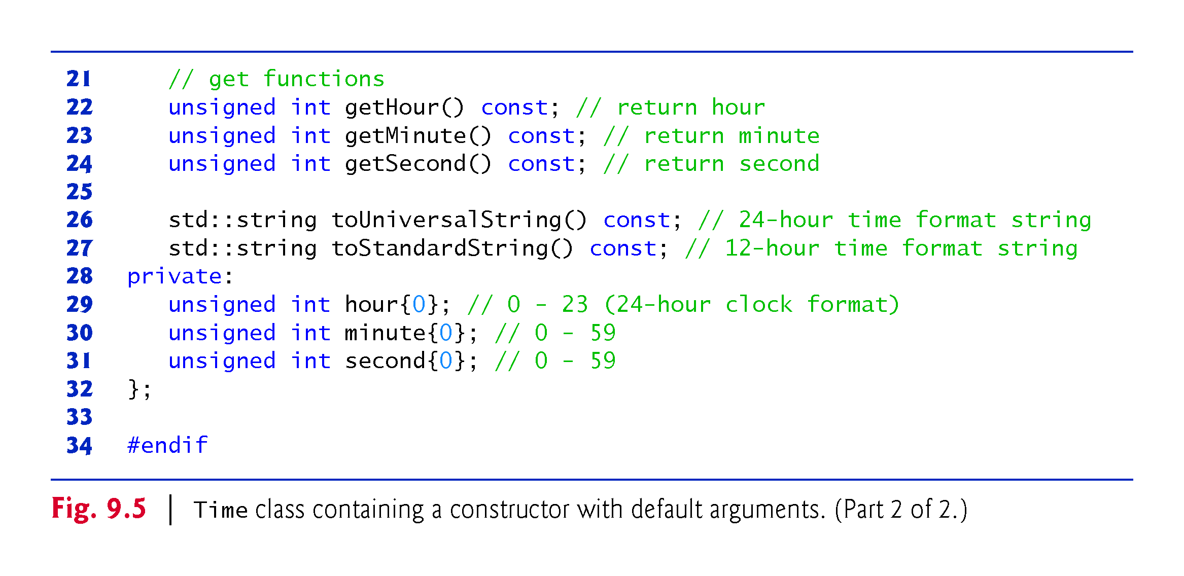

Slide 65
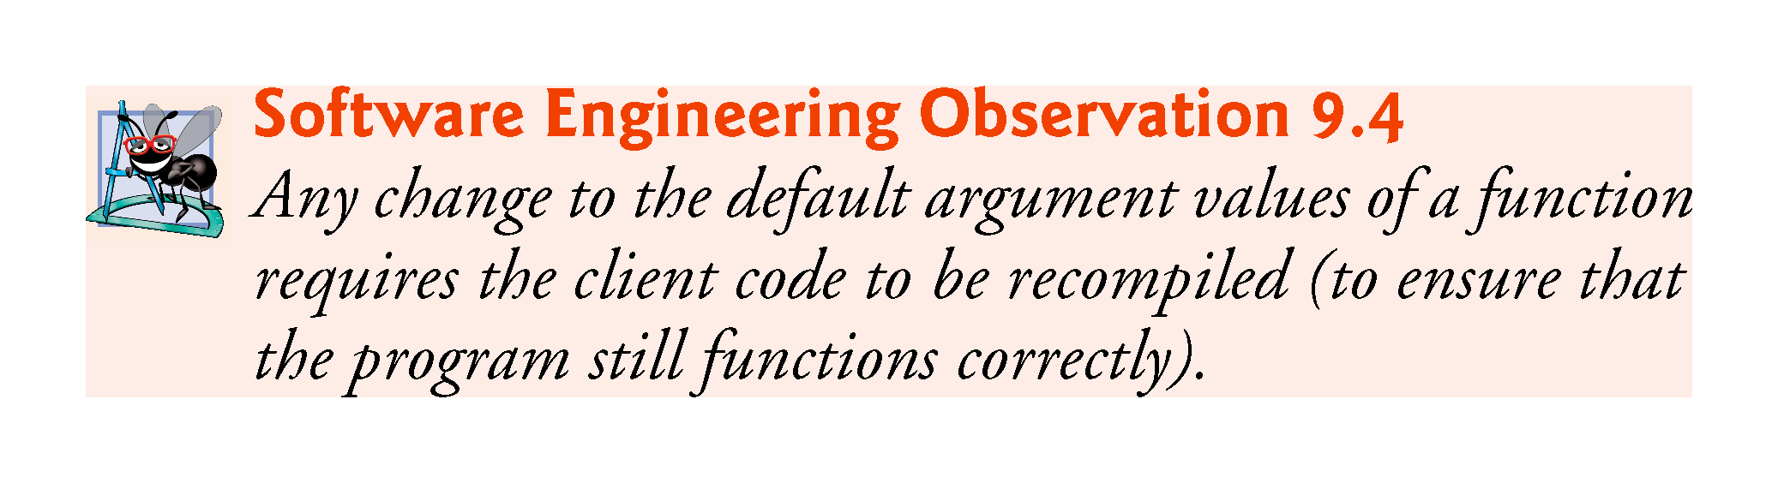

Slide 66
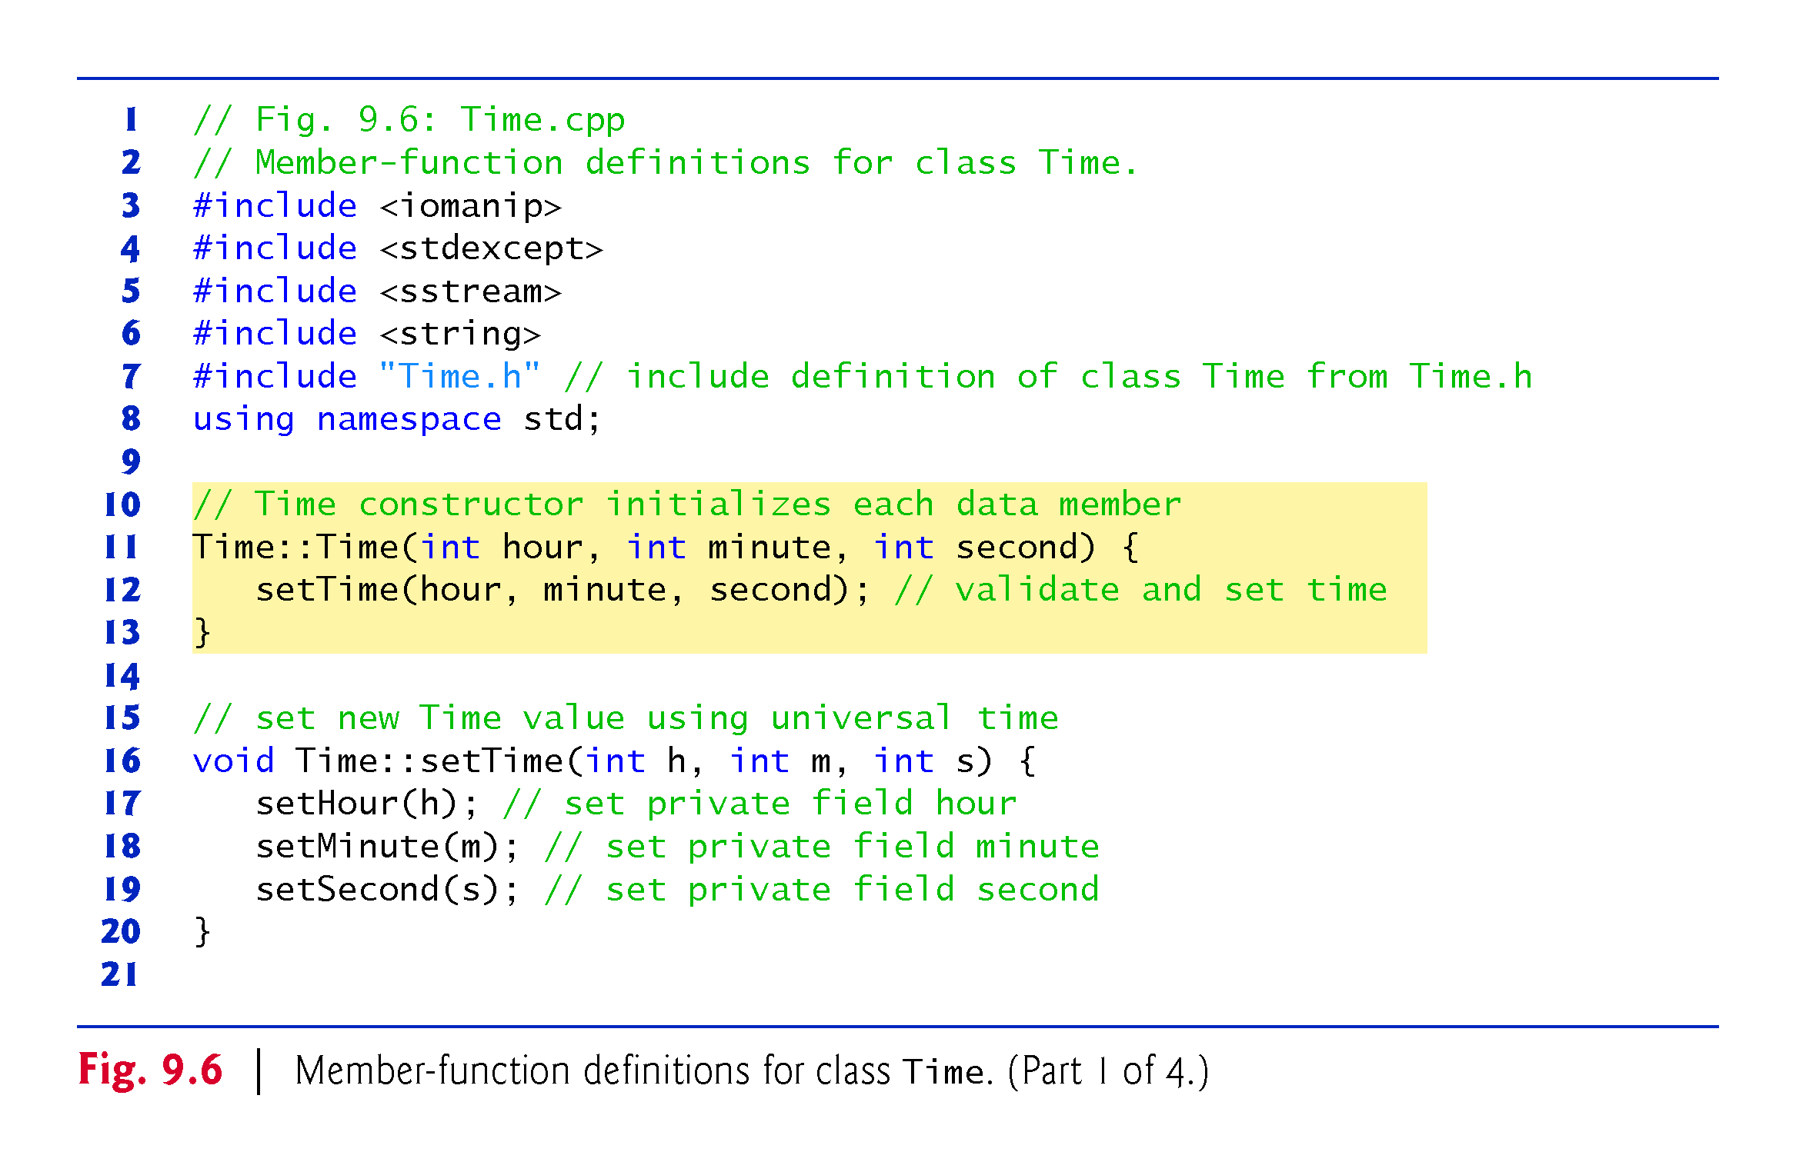

Slide 67
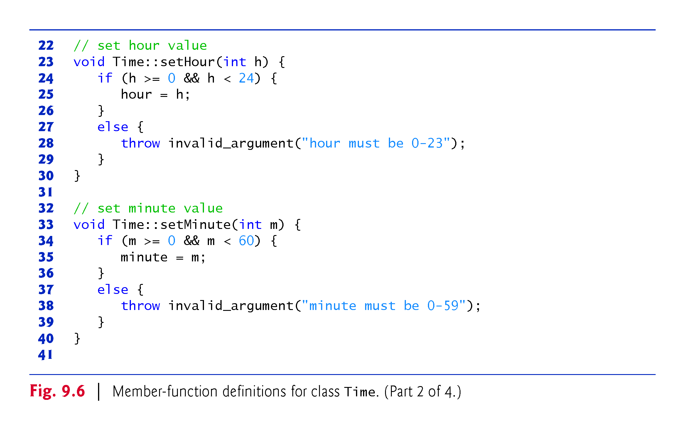

Slide 68
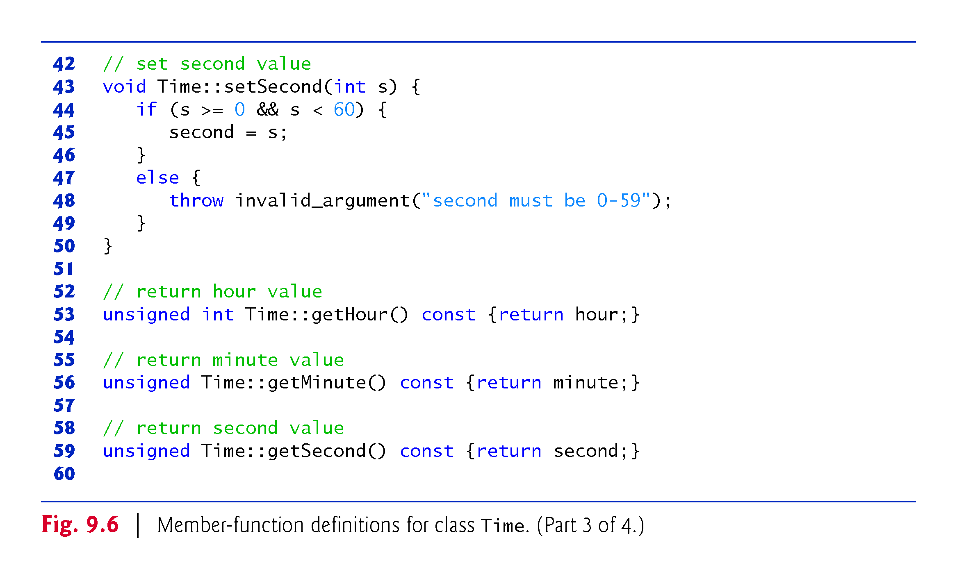

Slide 69
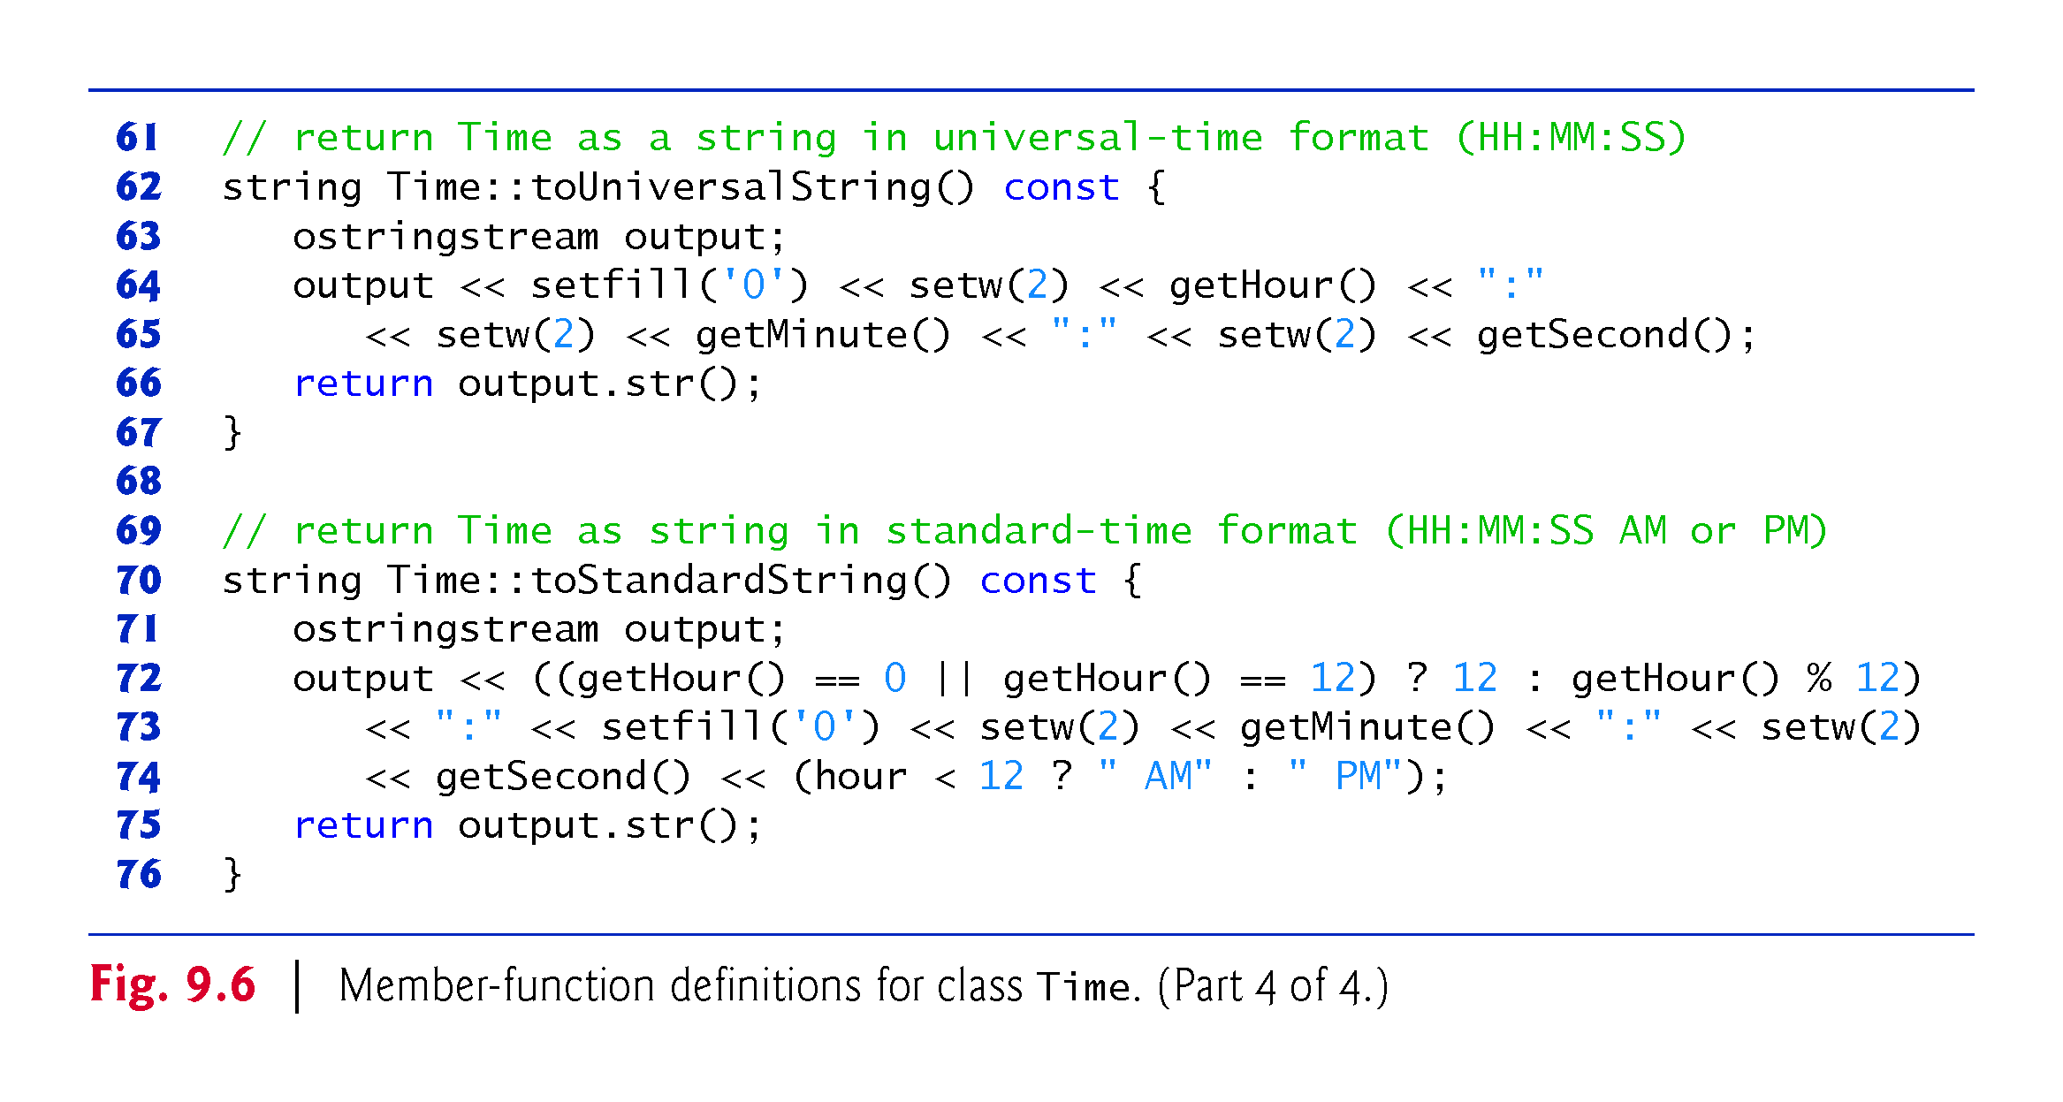

Slide 70
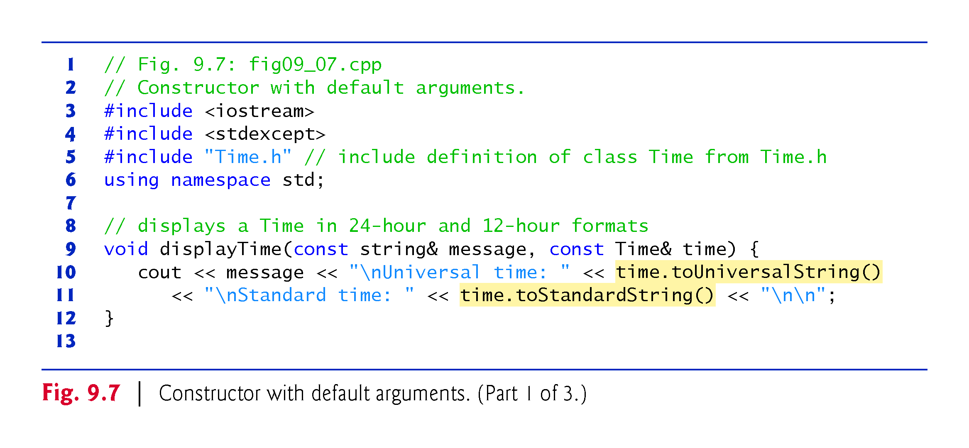

Slide 71
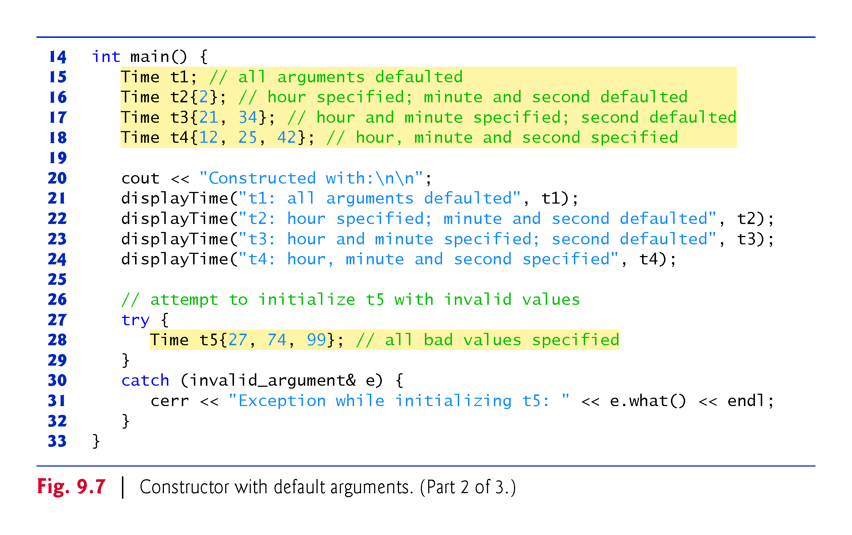

Slide 72
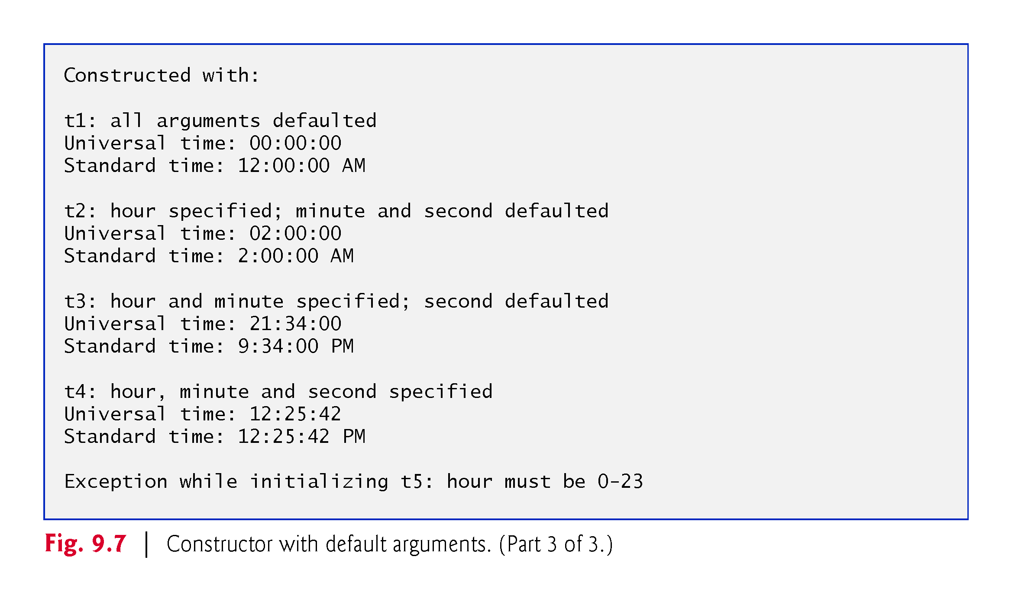

Slide 73
9.6 Time Class Case Study: Constructors with Default Arguments (cont.)
Notes Regarding Time’s Set and Get Functions and Constructor
Time’s set and get functions are called throughout the class’s body.
In each case, these functions could have accessed the class’s private data directly.
Consider changing the representation of the time from three int values (requiring 12 bytes of memory on systems with four-byte ints) to a single int value representing the total number of seconds that have elapsed since midnight (requiring only four bytes of memory).
If we made such a change, only the bodies of the functions that access the private data directly would need to change.
No need to modify the bodies of the other functions.

Slide 74
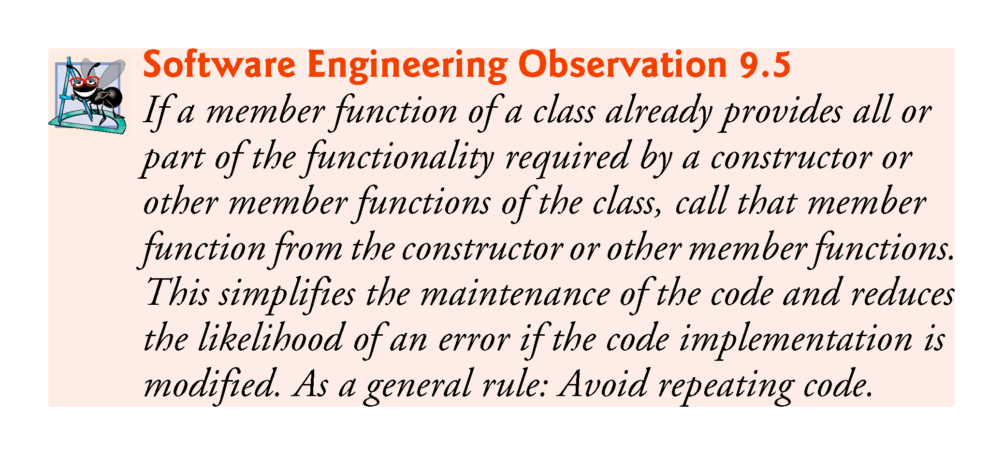

Slide 75
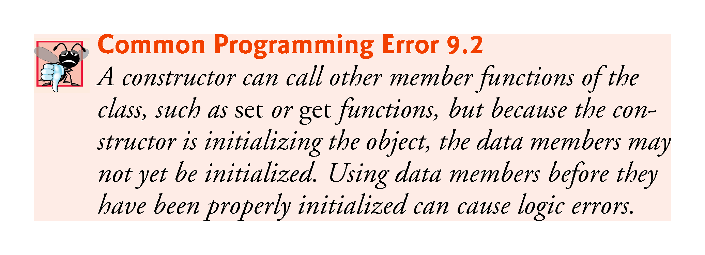

Slide 76


Slide 77
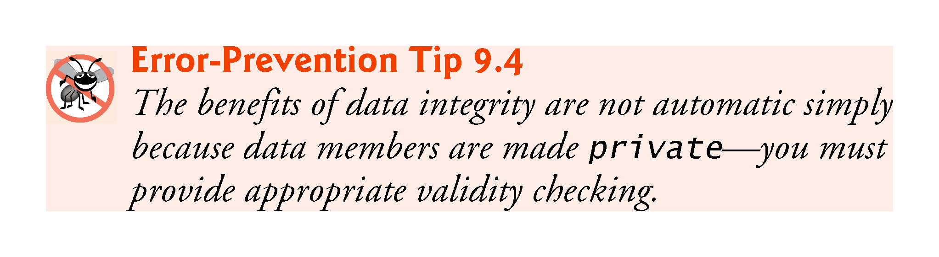

Slide 78
9.7 Destructors
The name of the destructor is the tilde character (~) followed by the class name.
Called implicitly when an object is destroyed.
The destructor itself does not actually release the object’s memory
it performs termination housekeeping before the object’s memory is reclaimed, so the memory may be reused to hold new objects
Receives no parameters and returns no value.
May not specify a return type—not even void.
A class has one destructor.
A destructor must be public.
If you do not explicitly define a destructor, the compiler defines an “empty” destructor.

Slide 79
9.8 When Constructors and Destructors Are Called
Constructors and destructors are called implicitly.
The order in which these function calls occur depends on the order in which execution enters and leaves the scopes where the objects are instantiated.
Generally, destructor calls are made in the reverse order of the corresponding constructor calls
Global and static objects can alter the order in which destructors are called.

Slide 80
9.8.1 Constructors and Destructors for Objects in Global Scope
Constructors are called for objects defined in global scope (also called global namespace scope) before any other function (including main) in that program begins execution (although the order of execution of global object constructors between files is not guaranteed).
The corresponding destructors are called when main terminates.
Function exit forces a program to terminate immediately and does not execute the destructors of local objects.
Function abort performs similarly to function exit but forces the program to terminate immediately, without allowing programmer-defined cleanup code to be called.

Slide 81
9.8.2 Constructors and Destructors for Non-static Local Objects
Constructors and destructors for non-static local objects are called each time execution enters and leaves the scope of the object.
Destructors are not called for non-static local objects if the program terminates with a call to function exit or function abort.

Slide 82
9.8.3 Constructors and Destructors for static Local Objects
The constructor for a static local object is called only once, when execution first reaches the point where the object is defined—the corresponding destructor is called when main terminates or the program calls function exit.
Global and static objects are destroyed in the reverse order of their creation.
Destructors are not called for static objects if the program terminates with a call to function abort.

Slide 83
9.8.4 Demonstrating When Constructors and Destructors Are Called
The program of Figs. 9.8–9.10 demonstrates the order in which constructors and destructors are called for objects of class CreateAndDestroy (Fig. 9.8 and Fig. 9.9) of various global, local and local static objects.

Slide 84
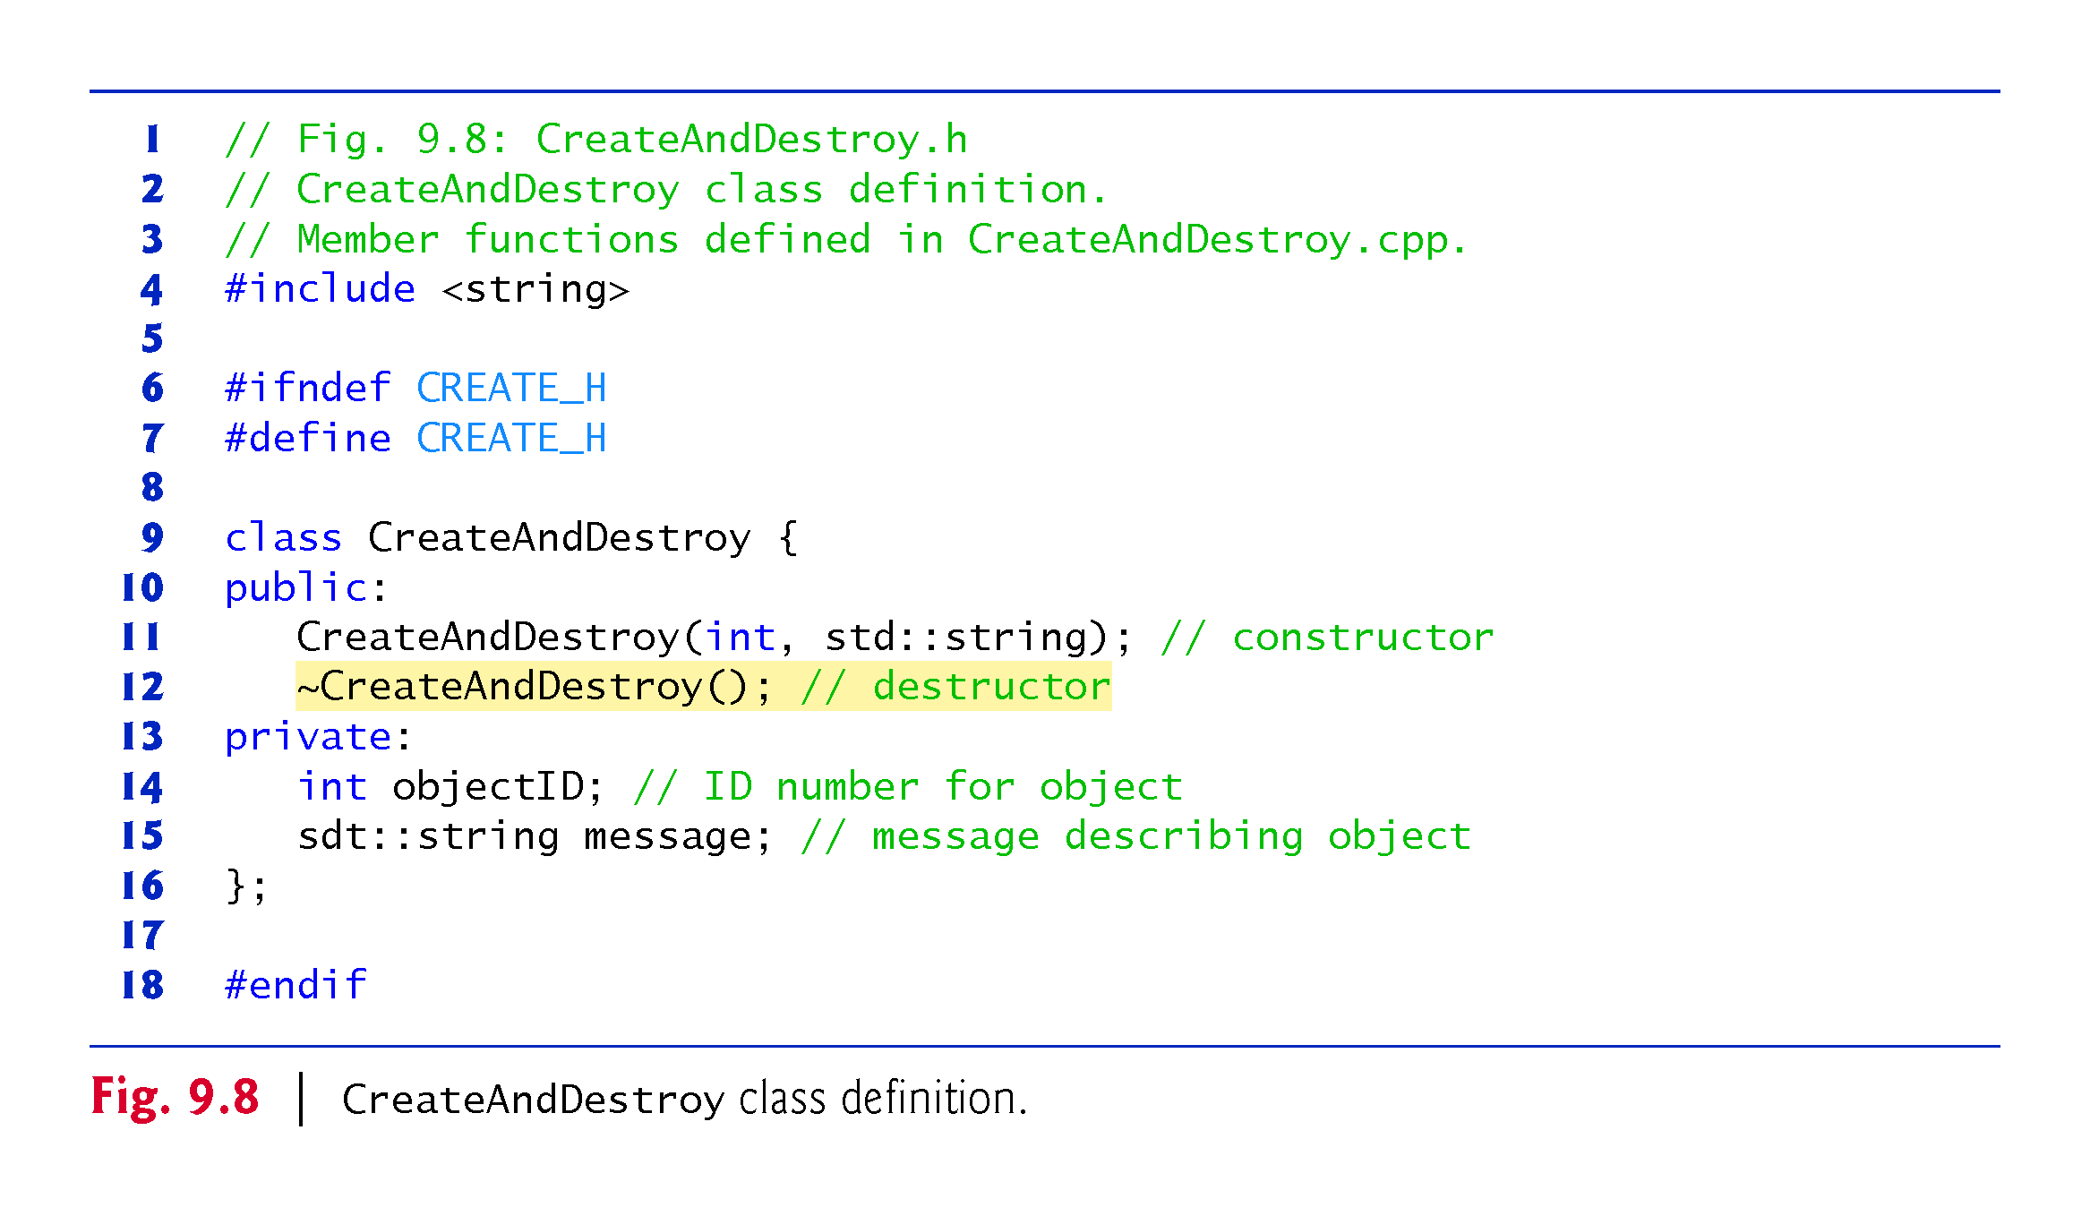

Slide 85
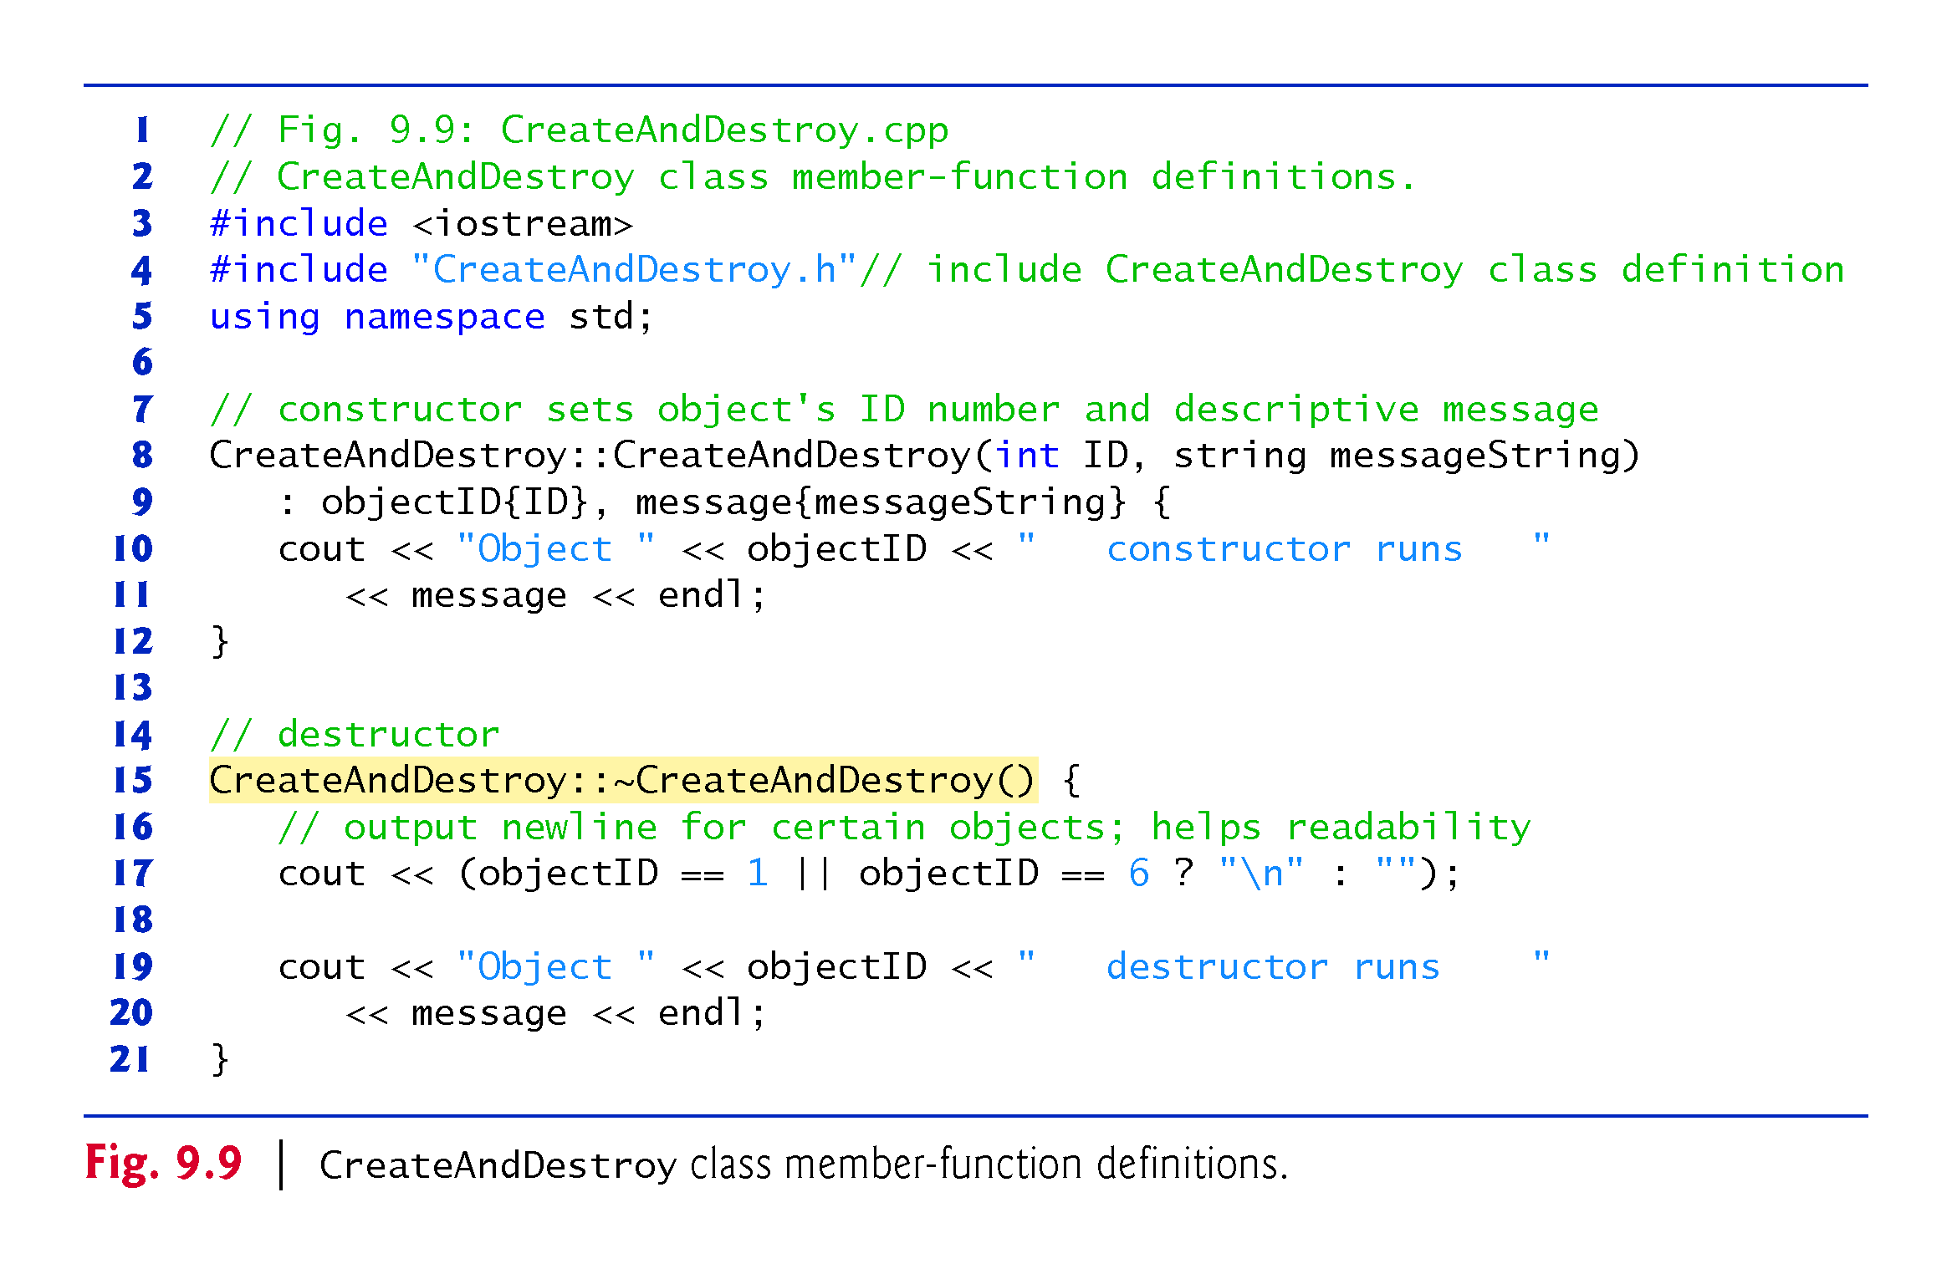

Slide 86
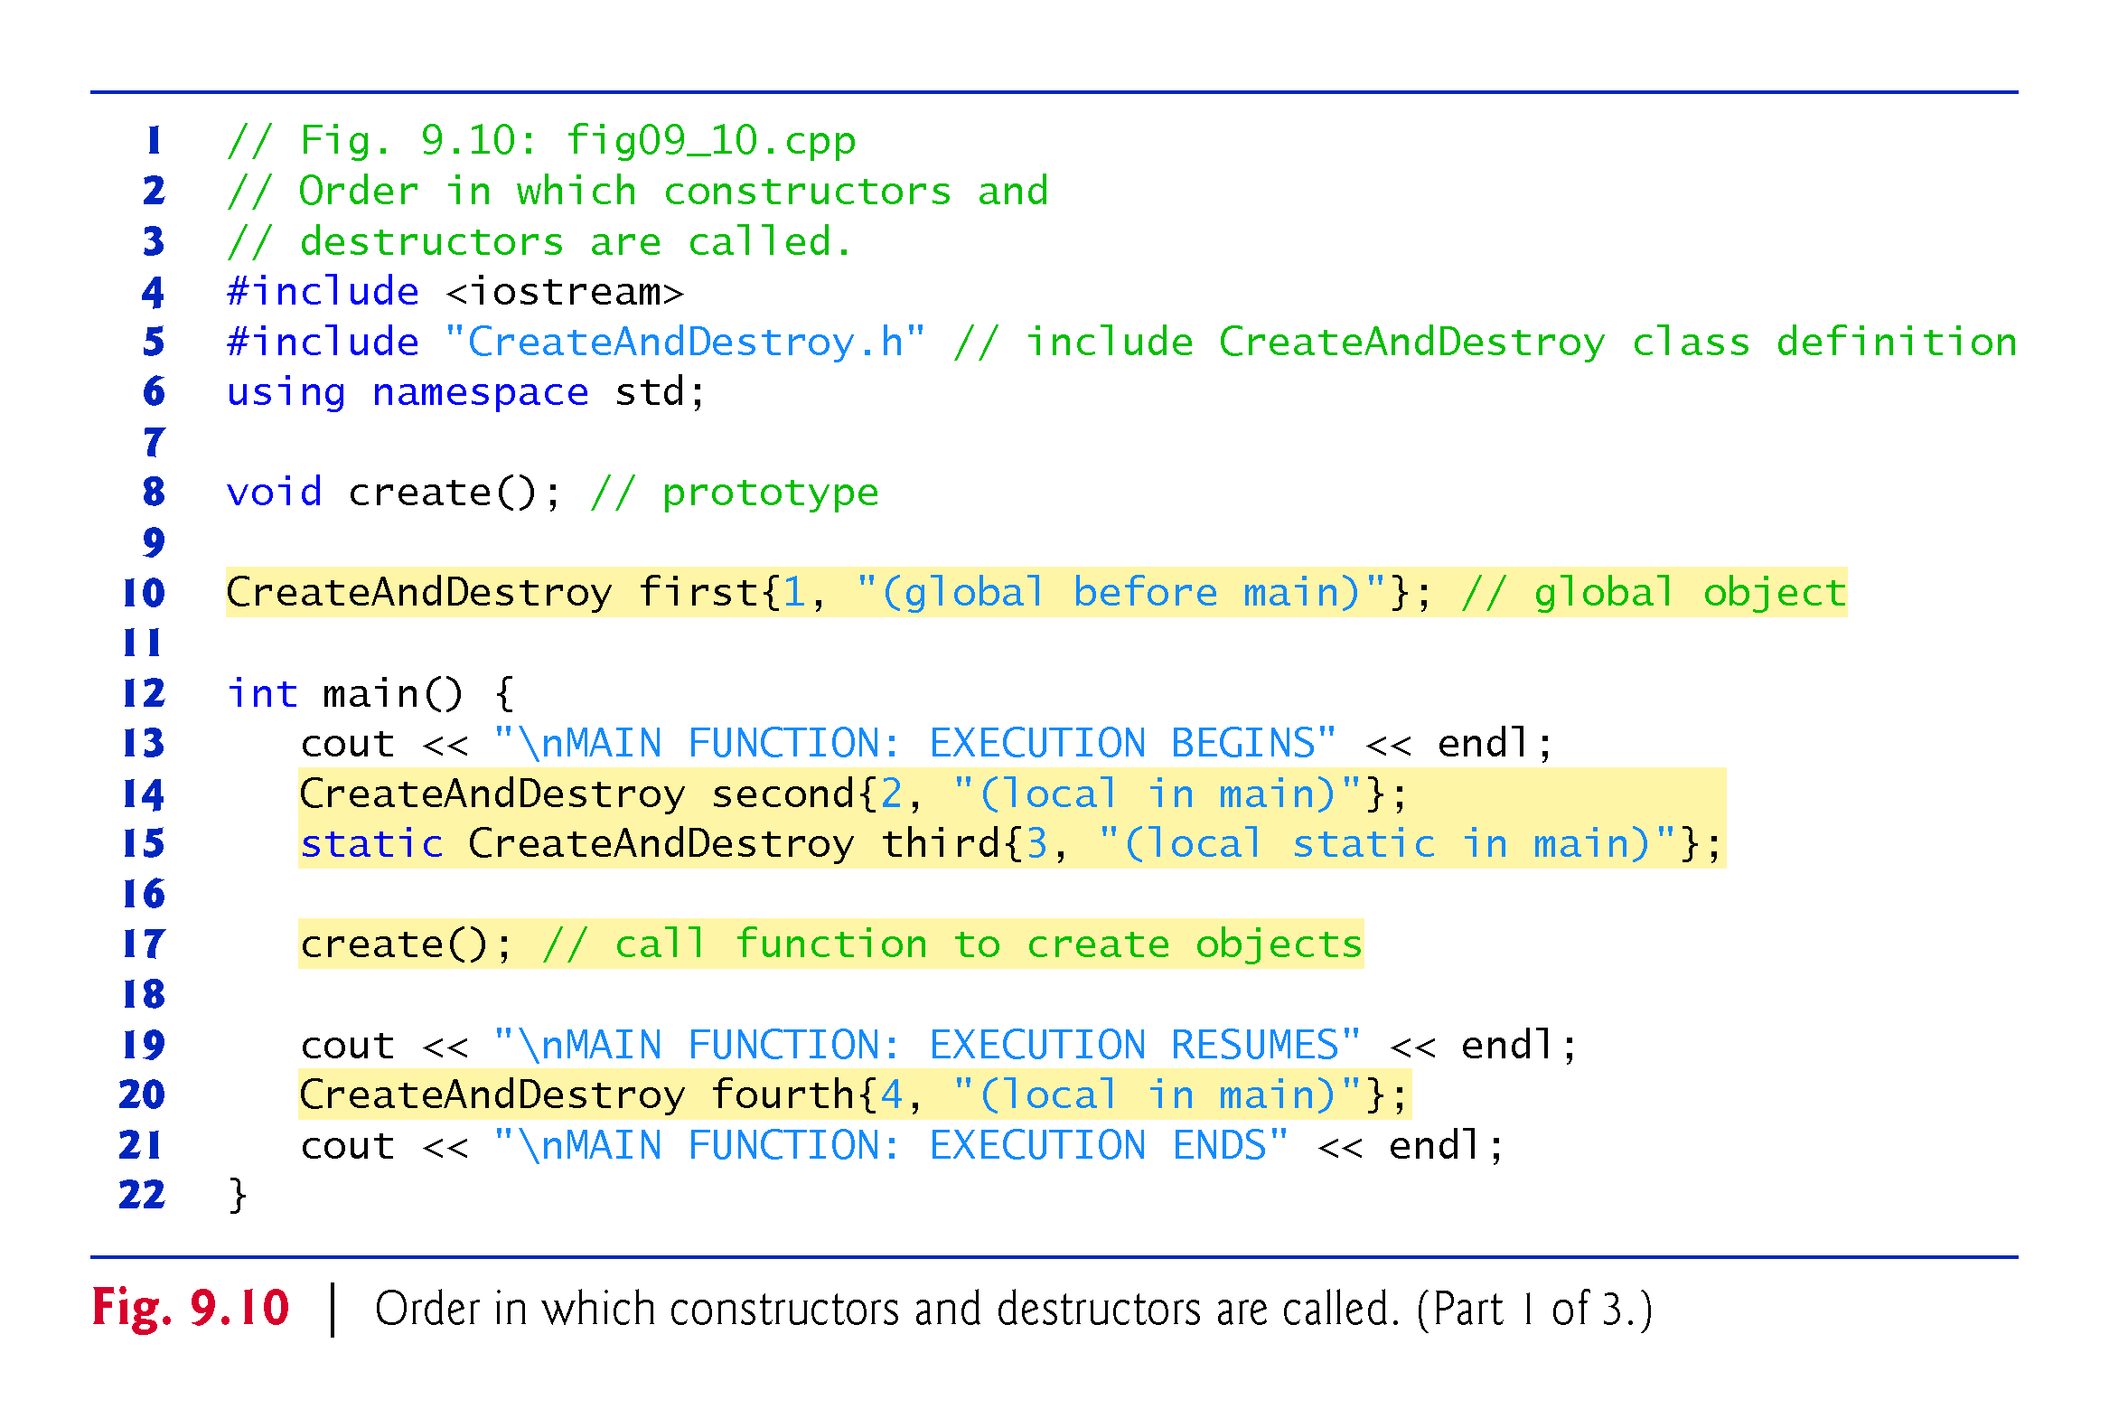

Slide 87
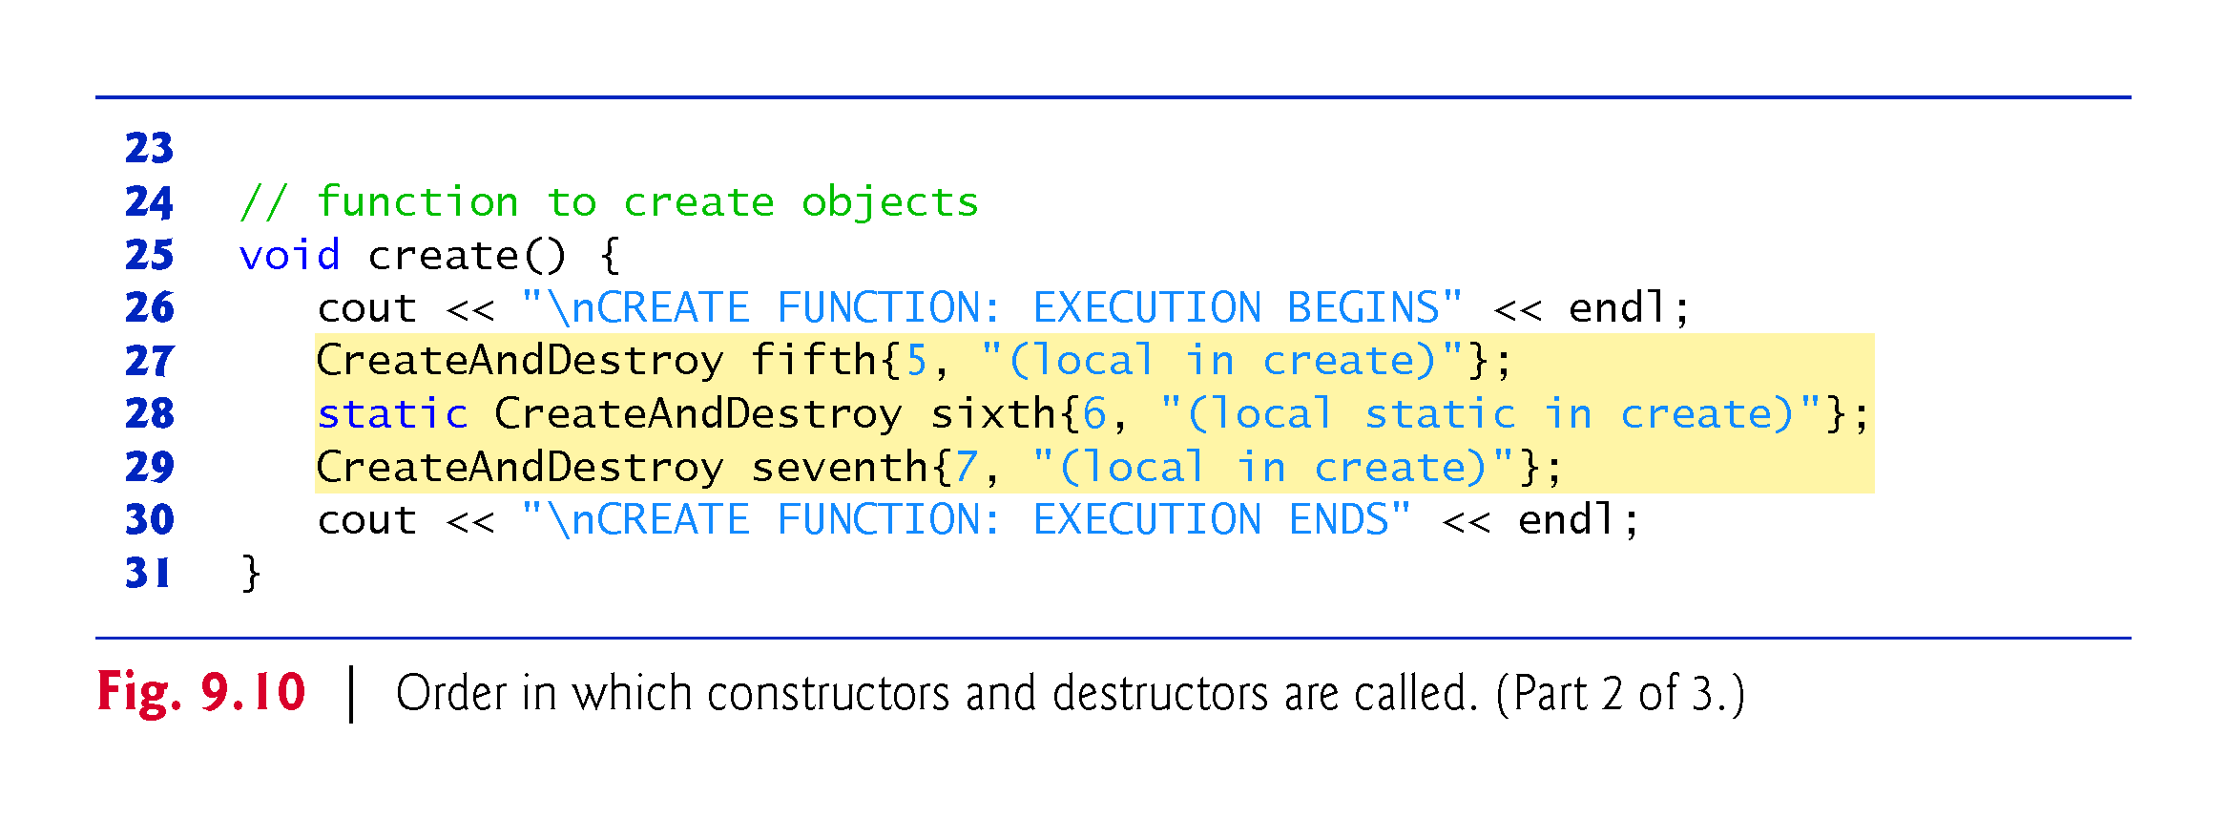

Slide 88
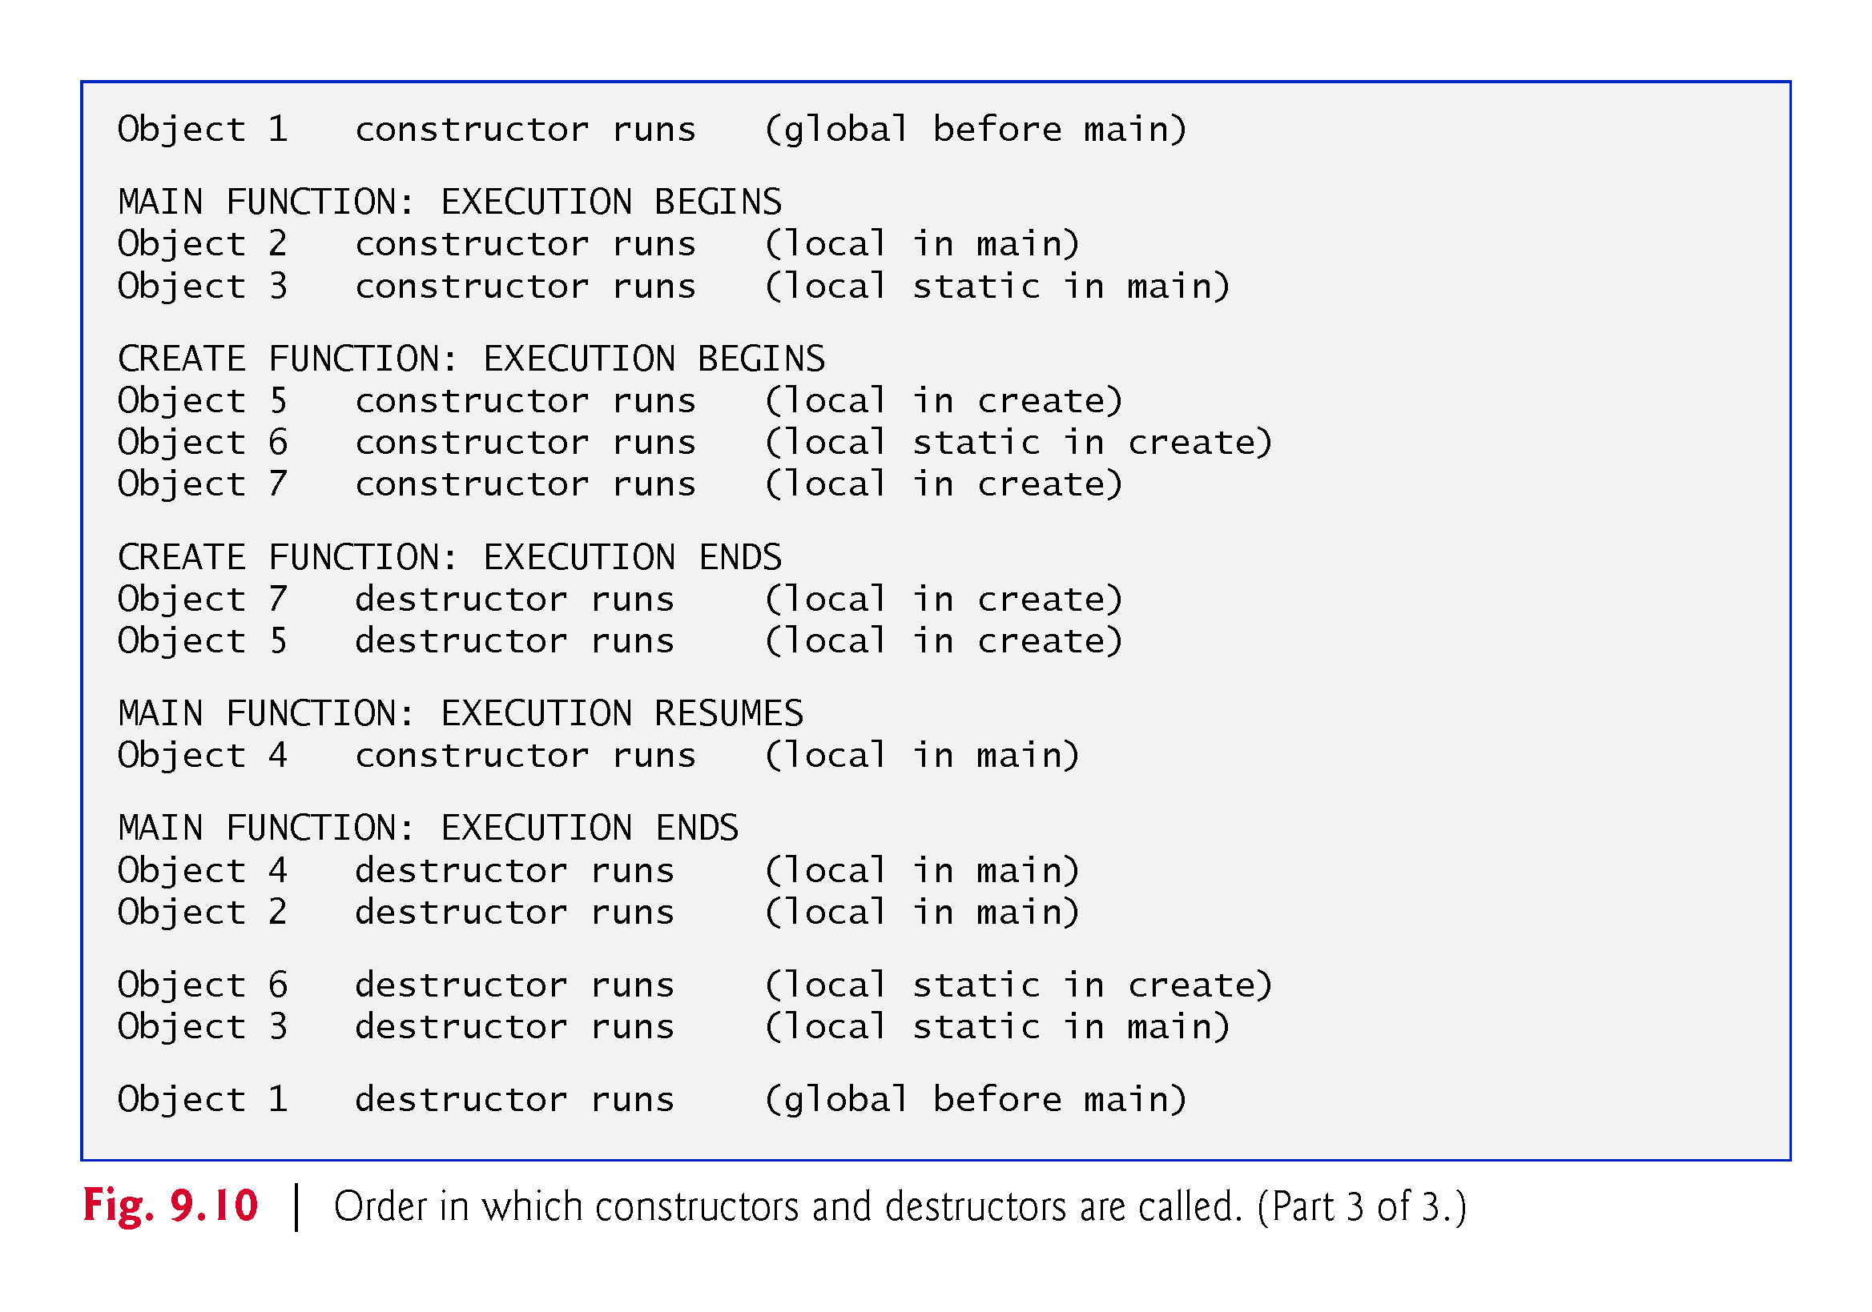

Slide 89
9.10 Default Memberwise Assignment
The assignment operator (=) can be used to assign an object to another object of the same type.
By default, such assignment is performed by memberwise assignment (also called copy assignment).
Each data member of the object on the right of the assignment operator is assigned individually to the same data member in the object on the left of the assignment operator.
[Caution: Memberwise assignment can cause serious problems when used with a class whose data members contain pointers to dynamically allocated memory; we discuss these problems in Chapter 10 and show how to deal with them.]

Slide 90
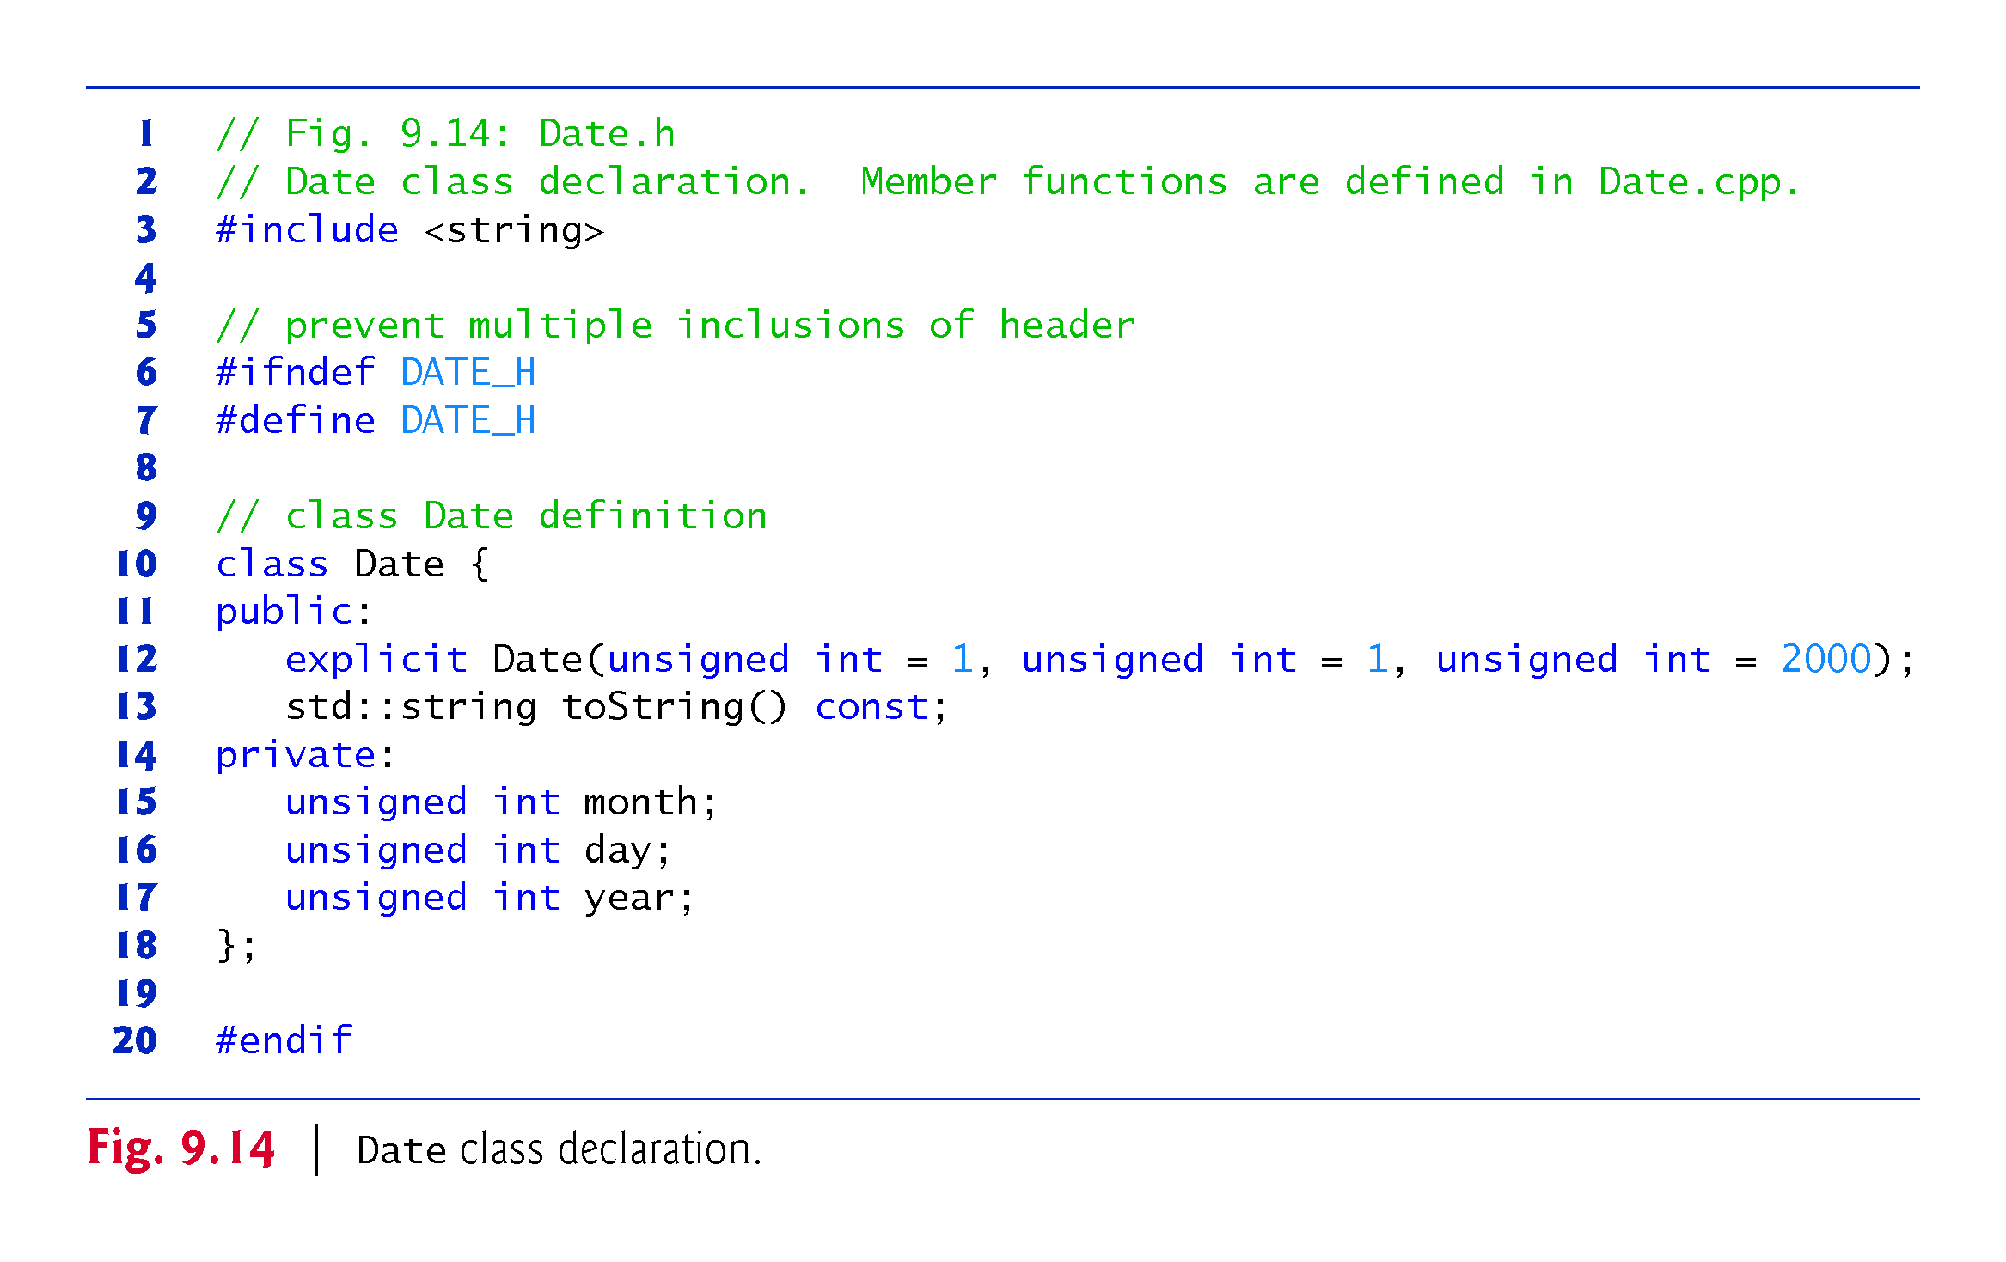

Slide 91
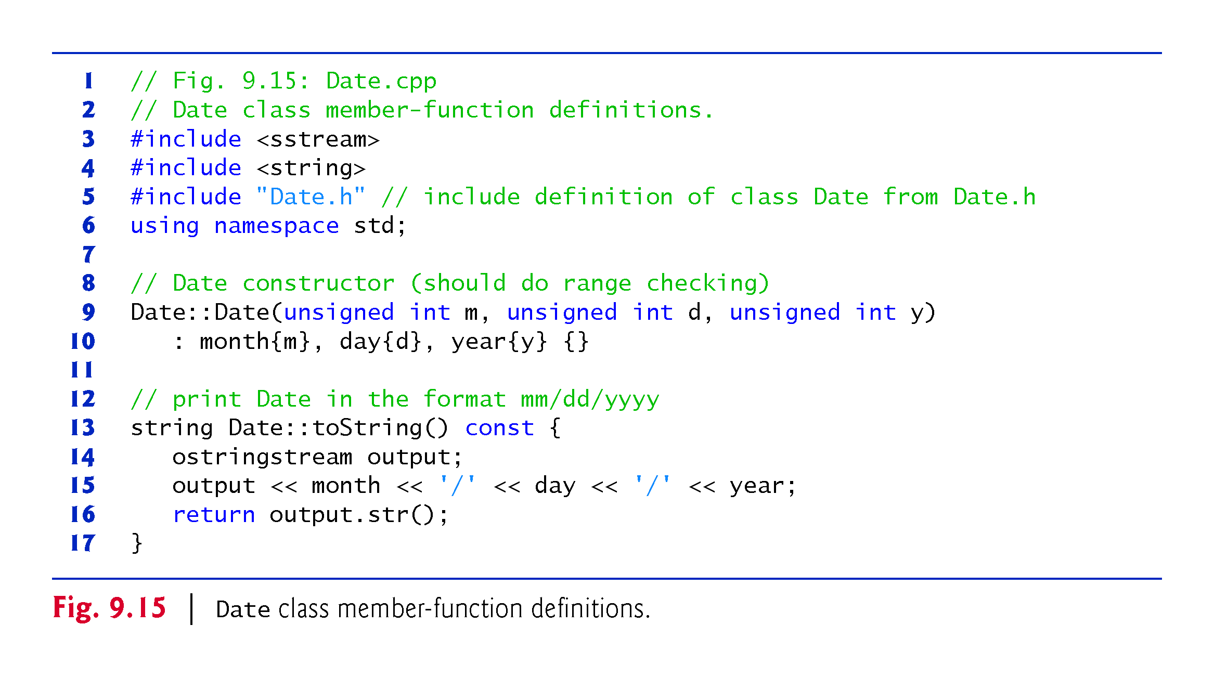

Slide 92
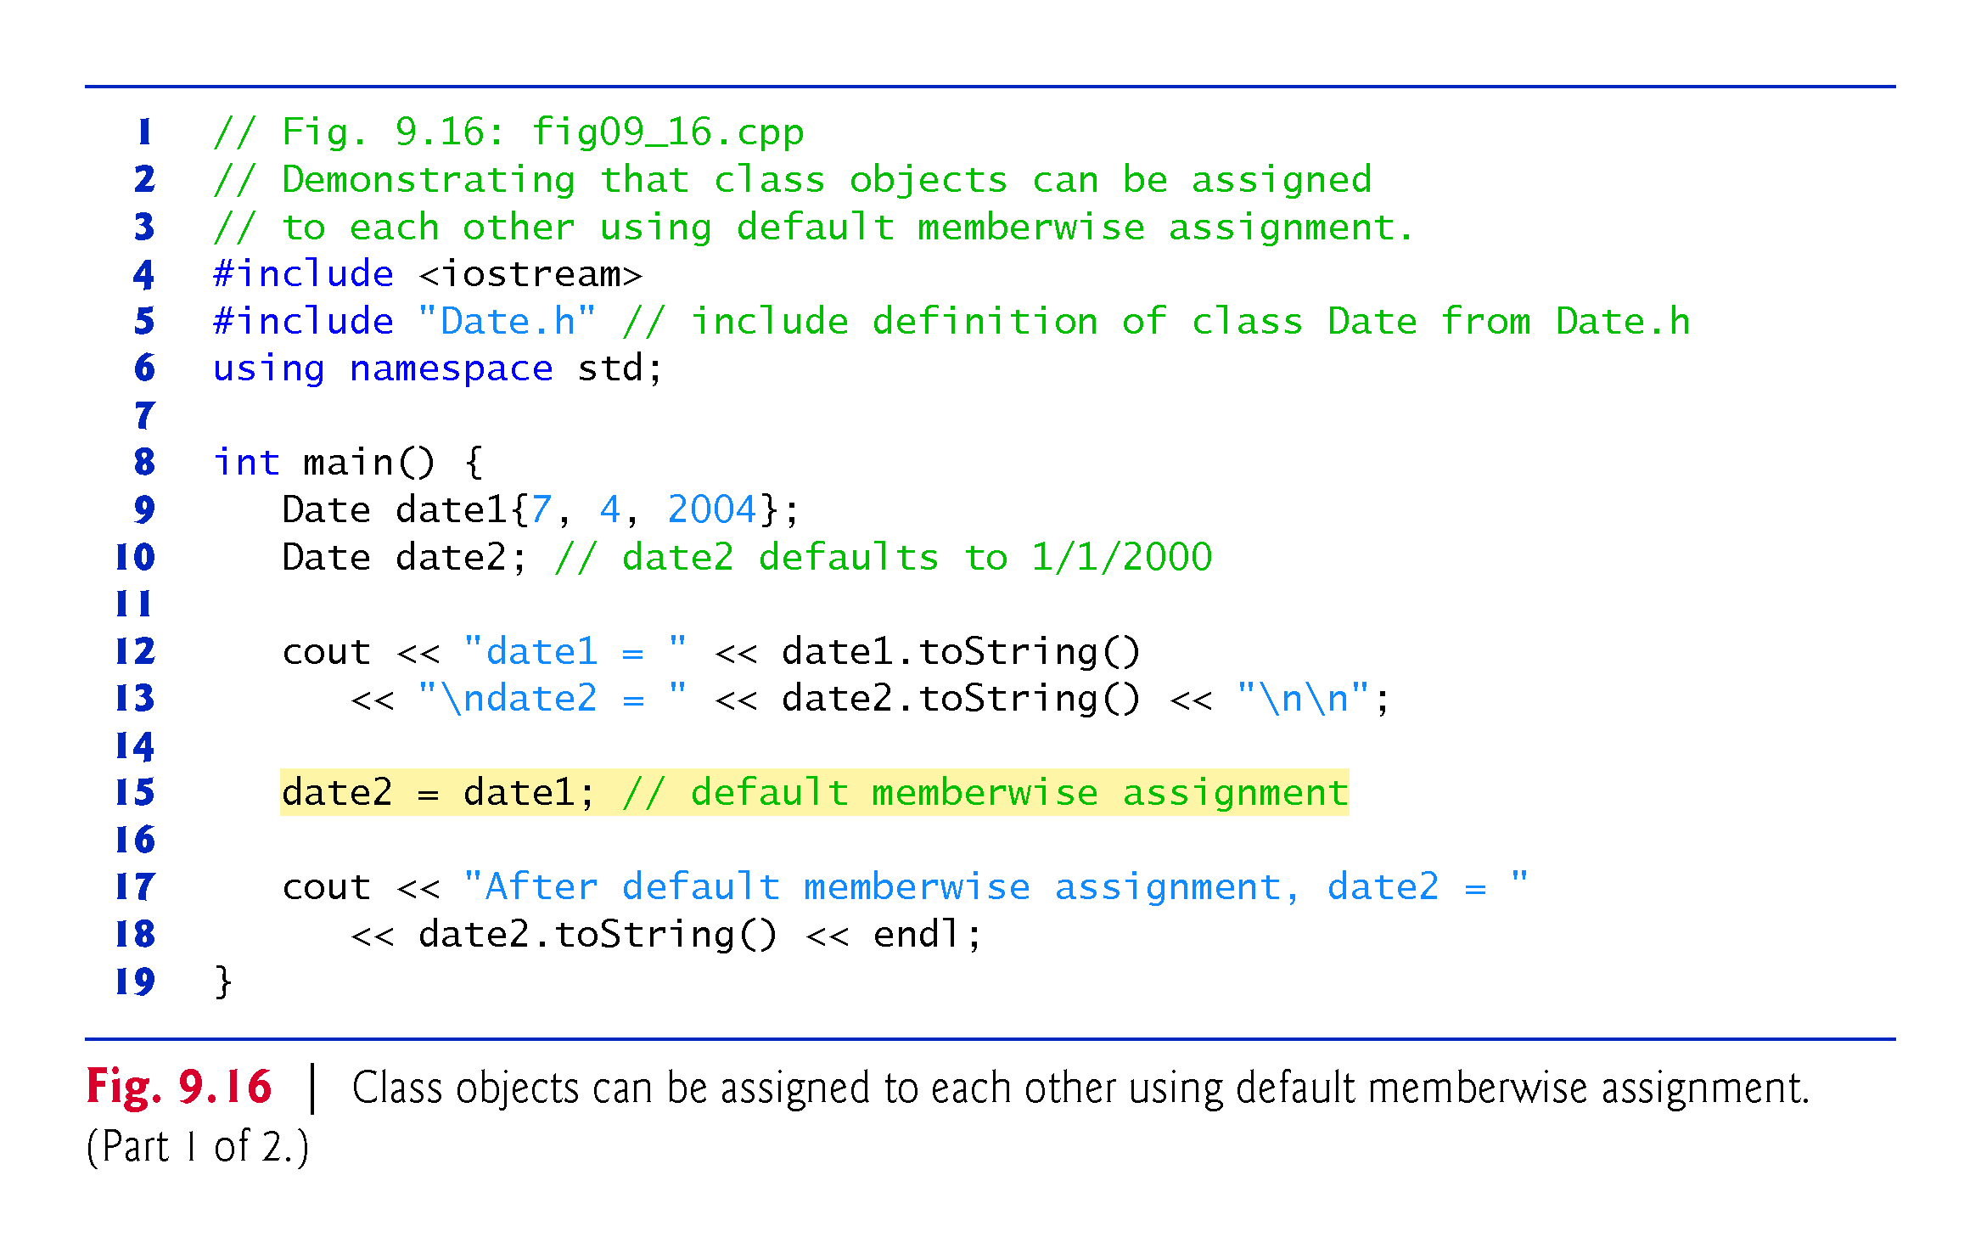

Slide 93
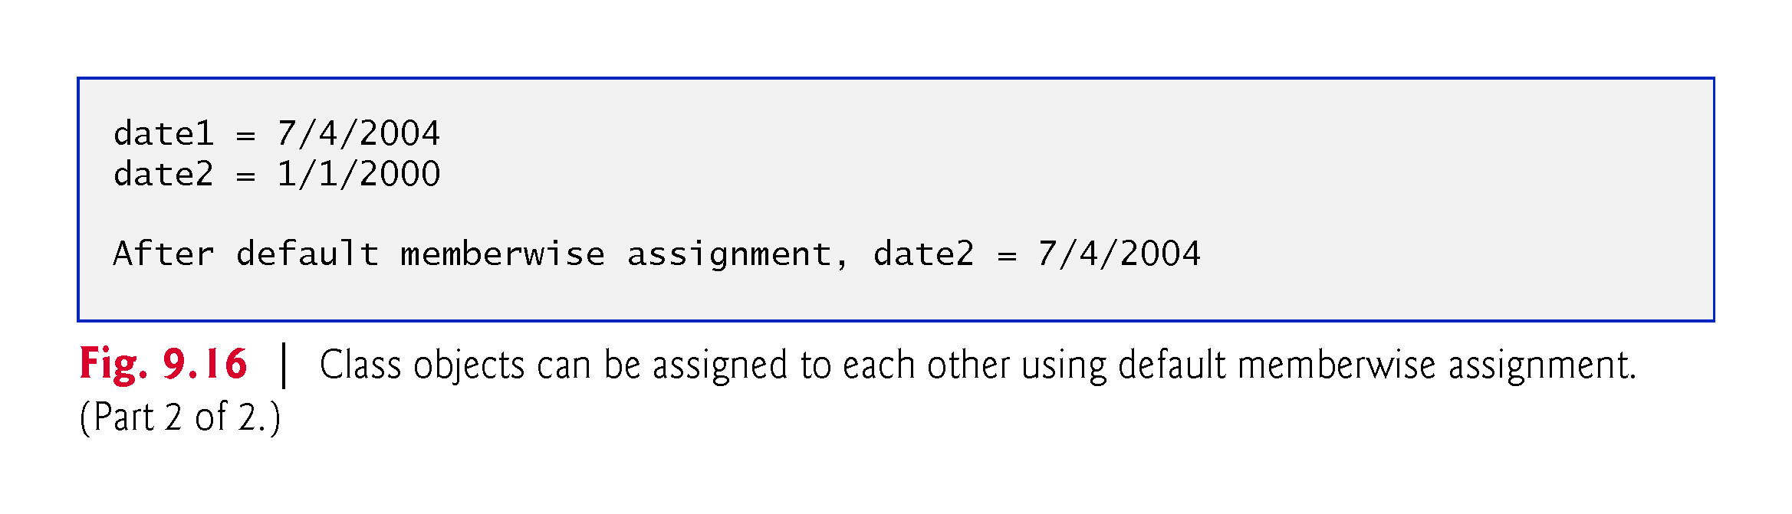

Slide 94
9.10 Default Memberwise Assignment (cont.)
Objects may be passed as function arguments and may be returned from functions.
Such passing and returning is performed using pass-by-value by default—a copy of the object is passed or returned.
C++ creates a new object and uses a copy constructor to copy the original object’s values into the new object.
For each class, the compiler provides a default copy constructor that copies each member of the original object into the corresponding member of the new object.
Copy constructors can cause serious problems when used with a class whose data members contain pointers to dynamically allocated memory.
Chapter 10 discusses customized copy constructors.

Slide 95
9.11 const Objects and const Member Functions
Some objects need to be modifiable and some do not.
You may use keyword const to specify that an object is not modifiable and that any attempt to modify the object should result in a compilation error.
The statement
const Time noon( 12, 0, 0 );
declares a const object noon of class Time and initializes it to 12 noon. It’s possible to instantiate const and non- const objects of the same class.

Slide 96
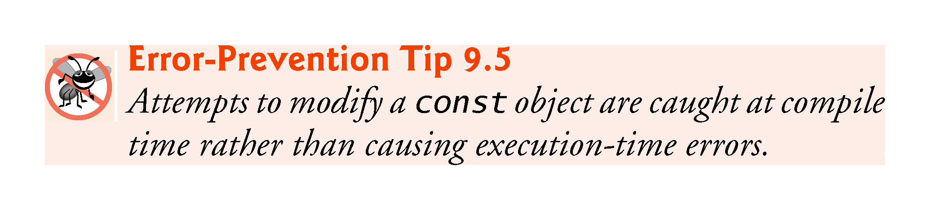

Slide 97
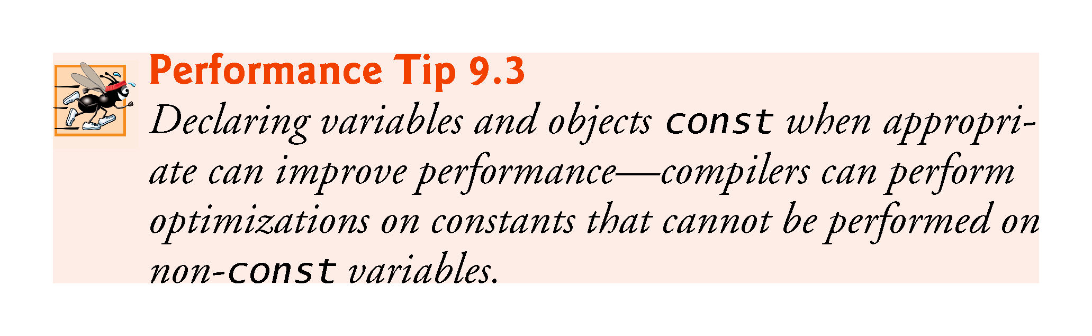

Slide 98
9.10 const Objects and const Member Functions (cont.)
C++ disallows member function calls for const objects unless the member functions themselves are also declared const.
This is true even for get member functions that do not modify the object.
This is also a key reason that we’ve declared as const all member-functions that do not modify the objects on which they’re called.

Slide 99
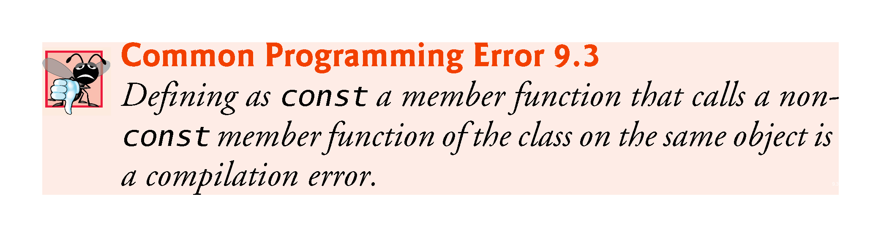

Slide 100


Slide 101
9.11 const Objects and const Member Functions (cont.)
A constructor must be allowed to modify an object so that the object can be initialized properly.
A destructor must be able to perform its termination housekeeping chores before an object’s memory is reclaimed by the system.
Attempting to declare a constructor or destructor const is a compilation error.
The “constness” of a const object is enforced from the time the constructor completes initialization of the object until that object’s destructor is called.

Slide 102
9.11 const Objects and const Member Functions (cont.)
Using const and Non-const Member Functions
The program of Fig. 9.16 uses class Time from Figs. 9.4–9.5, but removes const from function toStandardString’s prototype and definition so that we can show a compilation error.

Slide 104
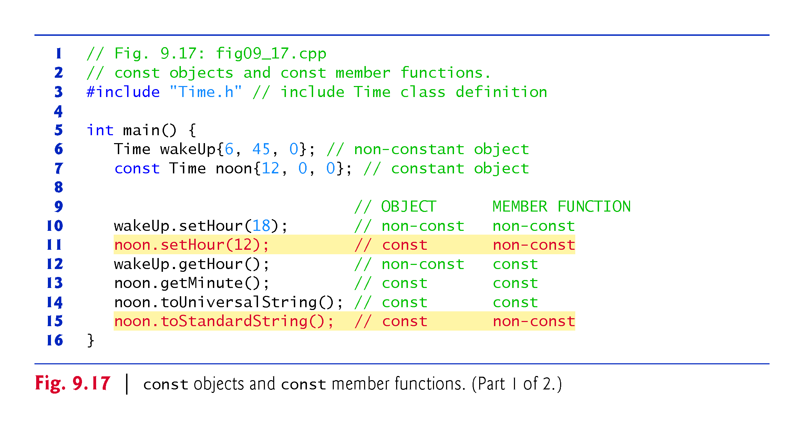

Slide 105
